Slide 1



[ Add images and delete text in red-instructions and this page ]
IAD NEW First-Year Review 2023
[Your name & or A # may not appear in this or your submission will be disqualified]

Slide 2
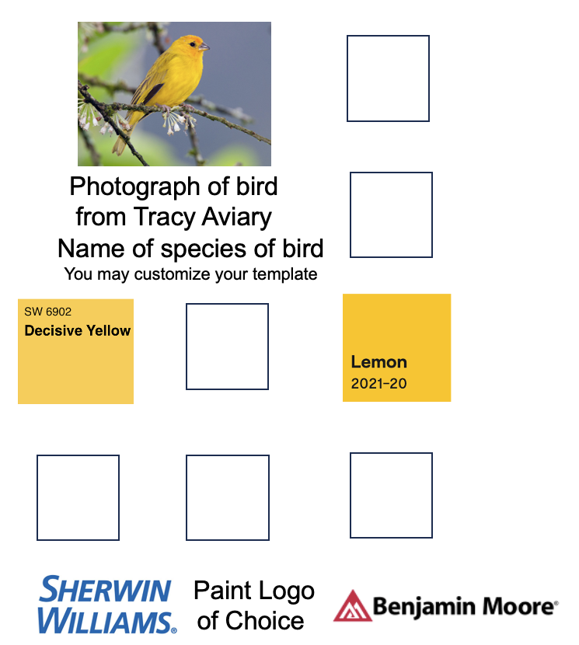
Insert your Color Findings Here & Delete this Text
Photograph(s) of Bird Sculpture

Slide 3

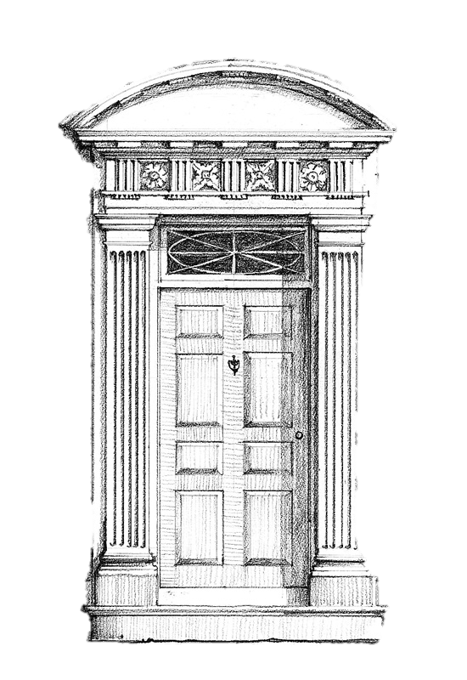
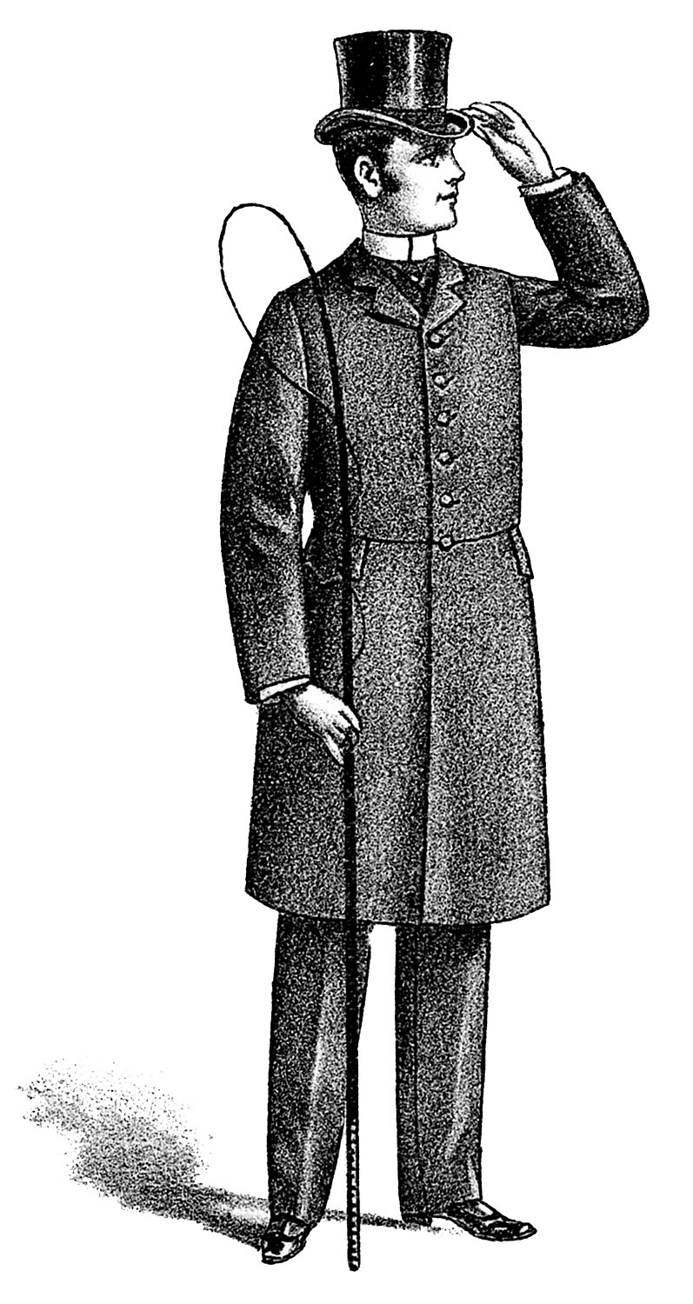
Mural

Slide 4
Design Thinking Sketch Notes
Based on lyrics “Bird Set Free” by Sia

Slide 5
Box in the Style of Joseph Cornell

Slide 6
Vision/Concept Precedent Board Based on Modern Architecture

Slide 7
Photograph of Bird Cage/Bird House
Photograph of Bird Cage/Bird House

Slide 8
4 Altoid Boxes

Slide 9
Best Sketch Notes From IAD 2780

Slide 10
4 Renderings

Slide 11
Best Rendering
Not shown in the previous slide

