Slide 1
Informative and Inspiring Mathematical Writing (with Students)
Jim Powell
Departments of Mathematics/Biology
Utah State University

Slide 2
Here I will
Discuss the (student) Writing Gap

Slide 3
Here I will
Discuss the (student) Writing Gap
Present a Unified Theory of Mathematical Writing

Slide 4
Here I will
Discuss the (student) Writing Gap
Present a Unified Theory of Mathematical Writing
Propose Launching and Scaffolding strategies for (student) authors

Slide 5
Here I will
Discuss the (student) Writing Gap
Present a Unified Theory of Mathematical Writing
Propose Launching and Scaffolding strategies for (student) authors
Work through some specific Math-Communication Issues including
Cushioning Equations and Presenting Pictures
Tightening Sentences/Punchy Paragraphs

Slide 6
Here I will
Discuss the (student) Writing Gap
Present a Unified Theory of Mathematical Writing
Propose Launching and Scaffolding strategies for (student) authors
Work through some specific Math-Communication Issues including
Cushioning Equations and Presenting Pictures
Tightening Sentences/Punchy Paragraphs
Introduce a Review Rubric to use with (student) authors

Slide 7
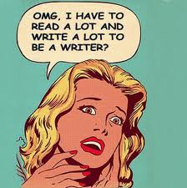
The Gap: Our Students Don’t
Take technical writing

Slide 8
The Gap: Our Students Don’t
Take technical writing
Write in their math classes

Slide 9
The Gap: Our Students Don’t
Take technical writing
Write in their math classes
Learn how to outline

Slide 10
The Gap: Our Students Don’t
Take technical writing
Write in their math classes
Learn how to outline
Read mathematics papers

Slide 11
The Gap: Our Students Don’t
Take technical writing
Write in their math classes
Learn how to outline
Read mathematics papers
Read mathematics papers for style and presentation

Slide 12
The Gap: Our Students Don’t
Take technical writing
Write in their math classes
Learn how to outline
Read mathematics papers
Read mathematics papers for style and presentation
Learn the 5 paragraph essay format

Slide 13
The Gap: Our Students Don’t
Take technical writing
Write in their math classes
Learn how to outline
Read mathematics papers
Read mathematics papers for style and presentation
Learn the 5 paragraph essay format
Know how much time successful professors spend writing

Slide 14
Unified Theory of mathematical Writing

Slide 15
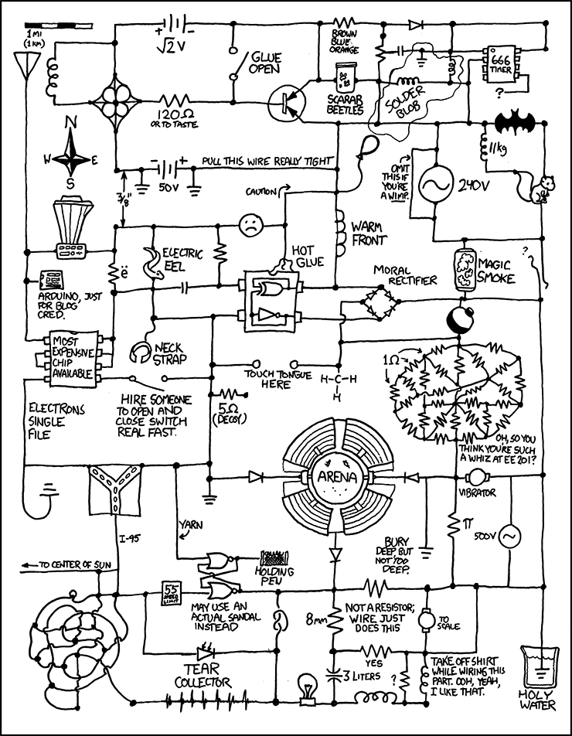
The Theory
(how students see writing)

Slide 16
The Theory
(how students see writing)
YOU ARE
HERE

Slide 17
The Theory
(how students see writing)
YOUR PAPER
IS HERE
YOU ARE
HERE

Slide 18
The Theory
Introduction
Thing 1
Body
Thing 2
One is Red, One is Blue
Conclusion

Slide 19
The Theory
Introduction
Tell `em what you’re
gonna tell them
Thing 1
Body
Thing 2
Tell `em
One is Red, One is Blue
Conclusion
Tell `em what you’ve
told them

Slide 20
The Theory
Context:
Literature Review
History of subject?
What has been done?
Introduction
Thing 1
Body
Thing 2
One is Red, One is Blue
Conclusion

Slide 21
The Theory
Context:
Literature Review
History of subject?
What has been done?
Introduction
Thing 1
Summary (Thematic) Paragraph:
What you propose to do, how you propose to do it, what the benefits are.
“In this paper we will do Thing 1 and Thing 2; one is Red and one is Blue.”
Body
Thing 2
One is Red, One is Blue
Conclusion

Slide 22
The Theory
Context:
Literature Review
History of subject?
What has been done?
Penultimate Paragraph:
Specific gap(s) left in past work?
Evident need for new approach?
Bait the hook; pose the question
Introduction
Thing 1
Summary (Thematic) Paragraph:
What you propose to do, how you propose to do it, what the benefits are.
“In this paper we will do Thing 1 and Thing 2; one is Red and one is Blue.”
Body
Thing 2
One is Red, One is Blue
Conclusion

Slide 23
The Theory
Problem Context
Penultimate Paragraph
Introduction
Summary (Thematic) Paragraph
Thing 1
(Summary)⁻¹ Paragraph:
What has been done, how it was done, how it worked. “In this paper we did Thing 1 and Thing 2; one was Red and one was Blue.”
Body
Thing 2
One is Red, One is Blue
Conclusion

Slide 24
The Theory
Problem Context
Penultimate Paragraph
Introduction
Summary (Thematic) Paragraph
Thing 1
(Summary)⁻¹ Paragraph:
What has been done, how it was done, how it worked. “In this paper we did Thing 1 and Thing 2; one was Red and one was Blue.”
Body
Thing 2
One is Red, One is Blue
Next Paragraph:
Filled gap(s) in past work? Needs
satisfied? Consequences of new
approach?
Conclusion

Slide 25
The Theory
Walk to the lake;
unpack the tackle
Bait the hook, throw it in
Introduction
Get the fish to bite, set the hook
Thing 1
Body
Thing 2
(Bring the fish to shore)
One is Red, One is Blue
Conclusion
Net the fish and take a good picture
Remove hook, release fish
Fish swims away

Slide 26
The Theory
Introduction
Thing 1
Body
Thing 2
One is Red, One is Blue
Conclusion

Slide 27
The Theory
Introduction
Thing 1
Body
Thing 2
One is Red, One is Blue
Conclusion

Slide 28

The Theory
Introduction
Thing 1
Body
Thing 2
One is Red, One is Blue
Conclusion

Slide 29
The Theory
Introduction
Thing 1
Body
Thing 2
One is Red, One is Blue
Conclusion

Slide 30
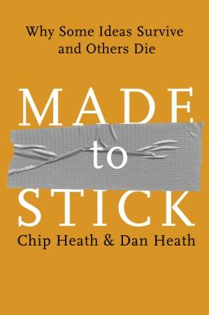
SUCCES(s) in communication – from Made to Stick
Simple
Unexpected
Concrete
Credible
Emotional
Storie(s)

Slide 31
SUCCES(s) in communication – from Made to Stick
Simple – have a clear core message
Unexpected
Concrete
Credible
Emotional
Storie(s)

Slide 32
SUCCES(s) in communication – from Made to Stick
Simple – have a clear core message
Unexpected – address a clear gap, have
an unexpected result
Concrete
Credible
Emotional
Storie(s)

Slide 33
SUCCES(s) in communication – from Made to Stick
Simple – have a clear core message
Unexpected – address a clear gap, have
an unexpected result
Concrete – make the message intuitive
Credible
Emotional
Storie(s)

Slide 34
SUCCES(s) in communication – from Made to Stick
Simple – have a clear core message
Unexpected – address a clear gap, have
an unexpected result
Concrete – make the message intuitive
Credible – provide sufficient support
Emotional
Storie(s)

Slide 35
SUCCES(s) in communication – from Made to Stick
Simple – have a clear core message
Unexpected – address a clear gap, have
an unexpected result
Concrete – make the message intuitive
Credible – provide sufficient support
Emotional – give the audience a reason to care
Storie(s)

Slide 36
SUCCES(s) in communication – from Made to Stick
Simple – have a clear core message
Unexpected – address a clear gap, have
an unexpected result
Concrete – make the message intuitive
Credible – provide sufficient support
Emotional – give the audience a reason to care
Storie(s) – tell a memorable story

Slide 37
The (Expanded) Theory
Introducing Context – Why should
the audience care (Emotion)?
Penultimate Paragraph – What is the
(Unexpected) gap in knowledge?
Introduction
Summary Paragraph – Simplest form of the
message and what Credible Story will be told
Thing 1
Tell the Story
Body
Thing 2
Provide Credible support
One is Red, One is Blue
Make the message Concrete
Conclusion
(Summary)⁻¹ – the Simple message, its Story, the Unexpected result why it’s Credible
The impact, consequences and why we
should have an Emotional reaction

Slide 38
Launching and scaffolding (Student) writers

Slide 39
Launching (things to think about first)
The Audience
The Venue
The Message

Slide 40
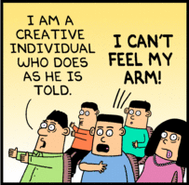
Who is the Audience?
Who are they?
What do they know?
What is valuable to them?
Where do they like to get their information?

Slide 41
Who is the Audience?
Who are they?
What do they know?
What is valuable to them?
Where do they like to get their information?
Pick a SPECIFIC person students know, if possible

Slide 42
What is the Venue?
Does the audience read this journal?
Will this journal publish this kind of work?
Are there specific requirements to publish here?

Slide 43
What is the Message?
What do you want your audience to take home?
What are the novel things that you have done or want to point out?
Why should people be interested?
What are the impacts?
What are your favorite pictures or diagrams illustrating this?

Slide 44
Scaffolding (a framework to get started)
Summary and Penultimate Paragraphs
What’s the Story?
Build an `Outline’

Slide 45
Summary and Penultimate Paragraphs
The Penultimate (next to last) paragraph
identifies gaps and needs to be addressed
connects the questions addressed in Summary to the body of current knowledge
tells the reader why they should care

Slide 46
Summary and Penultimate Paragraphs
The Penultimate (next to last) paragraph
identifies gaps and needs to be addressed
connects the questions addressed in Summary to the body of current knowledge
tells the reader why they should care
“Many researchers studying magic ponies acknowledge the existence of rainbows; conversely, rainbow theorists are uniformly delighted by enchanted horses. But nobody knows how to ride a magic pony underneath a pink rainbow.”

Slide 47
Summary and Penultimate Paragraphs
The Summary (final) paragraph
contains simplest version of what we want to say
highlights the storyline
summarizes the credible support
foreshadows results and impacts

Slide 48
Summary and Penultimate Paragraphs
The Summary (final) paragraph
contains simplest version of what we want to say
highlights the storyline
summarizes the credible support
foreshadows results and impacts
“In this paper we will put horses and rainbows on a common footing. First the horses will be enchanted, and then rainbows appear. It will turn out that rainbow coloring choice is optional. Not only can we produce color-neutral horse-rainbow dyads, but we can finally ride magical ponies through pink rainbows.”

Slide 49
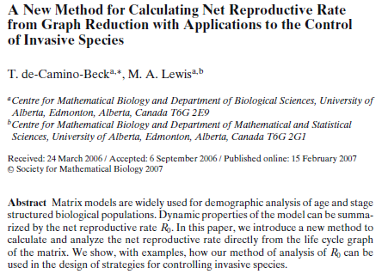
Example, Segel Prize Winner, SMB

Slide 50
Example, Segel Prize Winner, SMB
Title

Slide 51
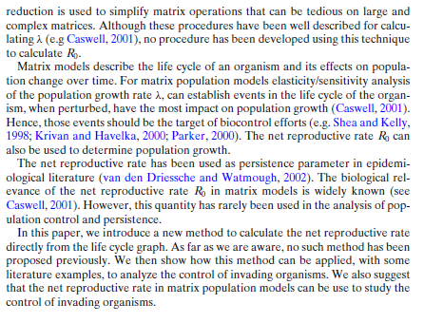
Context – why this
is important and
you should care

Slide 52
Penultimate ¶
What’s the gap
and why does it
need filling?

Slide 53
Baiting the
hook!
Baiting the
hook!

Slide 54
Summary
(thematic) ¶

Slide 55
Buzz!

Slide 56
Magic Ponies! Pink Rainbows!

Slide 57
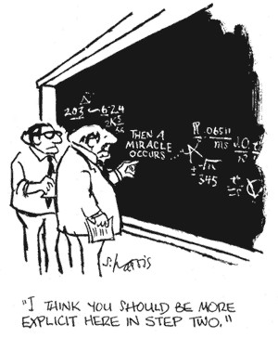
What’s the Story?
Students often struggle to see a storyline
Some natural story lines:
Logical (what things are prior to which – definitions, lemmas, theorems, corollaries)

Slide 58
What’s the Story?
Students often struggle to see a storyline
Some natural story lines:
Logical (what things are prior to which – definitions, lemmas, theorems, corollaries)
Historical (what came before
what and why)

Slide 59
What’s the Story?
Students often struggle to see a storyline
Some natural story lines:
Logical (what things are prior to which – definitions, lemmas, theorems, corollaries)
Historical (what came before
what and why)
Developmental (phenomena ->
model -> calibration -> validation)

Slide 60
What’s the Story?
Students often struggle to see a storyline
Some natural story lines:
Logical (what things are prior to which – definitions, lemmas, theorems, corollaries)
Historical (what came before
what and why)
Developmental (phenomena ->
model -> calibration -> validation)
Experimental (methods ->
results -> discussion)

Slide 61
Helping students find the natural story
Build a poster

Slide 62
Helping students find the natural story
Build a poster (get me out of the audience)

Slide 63
Helping students find the natural story
Build a poster (get me out of the audience)
Start with:
favorite pictures and diagrams
charismatic equations and explanations
short paragraphs on background and results

Slide 64
Helping students find the natural story
Build a poster (get me out of the audience)
Start with:
favorite pictures and diagrams
charismatic equations and explanations
short paragraphs on background and results
Put these on separate stickies/cards/sheets of paper
play with different organizations (stories!)
build it in Powerpoint
tangible benefit: a gorgeous poster!

Slide 65
Helping students find the natural story
Give a talk to peers (and get me out of the audience)

Slide 66
Helping students find the natural story
Give a talk to peers (and get me out of the audience)
Start with:
favorite pictures and diagrams
charismatic equations and explanations
bullets for main points to get across

Slide 67
Helping students find the natural story
Give a talk to peers (and get me out of the audience)
Start with:
favorite pictures and diagrams
charismatic equations and explanations
bullets for main points to get across
Teaching something is often the best way to see how it fits together
offer them a chance to do a `dry run’ with you first
tangible benefit: they give a talk!

Slide 68
Build an `Outline’
The majority of our students have never learned to outline, but that’s OK

Slide 69
Build an `Outline’
The majority of our students have never learned to outline, but that’s OK
All that’s required is a bulleted list
hitting the high points in order
lower-order bullets for supporting points, development, important pictures

Slide 70
Build an `Outline’
The majority of our students have never learned to outline, but that’s OK
All that’s required is a bulleted list
hitting the high points in order
lower-order bullets for supporting points, development, important pictures
Crucial thing is for students to reflect and see
what the story is
what the essential message is
what the credible support is

Slide 71
Math-Communication issues

Slide 72
Special Topics for Mathematical Writers
Cushioning Equations
Presenting Pictures
Tightening Sentences
Punching Up Paragraphs
Titillating Titles

Slide 73
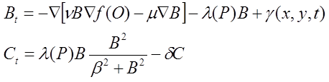
Cushioning Equations
Consider the equations

Slide 74
Cushioning Equations
Consider the equations
Where B is the number of beetles per acre and C is the
number of beetles colonizing pine hosts (P) per acre.

Slide 75
Cushioning Equations
If B is the number of beetles per acre and C is the
number of beetles colonizing pine hosts (P) per acre, then
where ν is the rate of attraction to odor plumes (O), the
diffusion constant, μ, measures the degree of randomness in
beetle trajectories, β is the density of attacking beetles which
gives a 50% chance of successful attack on host trees (P), ….

Slide 76
Cushioning Equations
If B is the number of beetles per acre and C is the
number of beetles colonizing pine hosts (P) per acre, then
Toward Host Odors
Random Motion
Emergence from Killed Hosts
Beetles Attacking New Hosts
Beetles Attacking New Hosts
Host Defenses
Probability of Beetle Success
where ν is the rate of attraction to odor plumes (O), the
diffusion constant, μ, measures the degree of randomness in
beetle trajectories, β is the density of attacking beetles which
gives a 50% chance of successful attack on host trees (P), ….

Slide 77
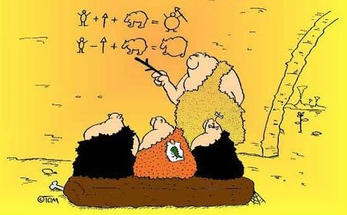
Presenting Pictures
A picture is worth 10³ words
is there a diagram or figure which makes your point?
pictures stick

Slide 78
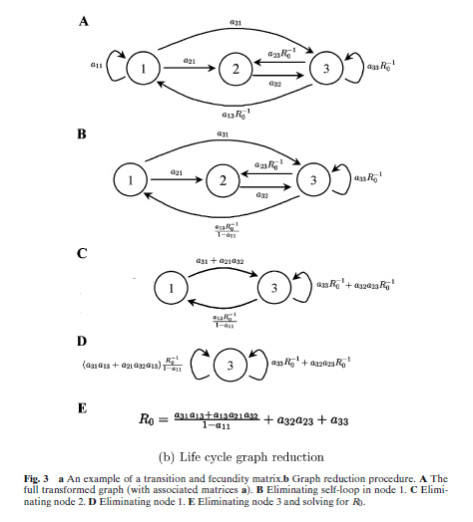

Presenting Pictures
From: T. de-Camino-Beck and M. Lewis (2007)
Bulletin of Math Biology 69: 1341-54

Slide 79
Presenting Pictures
A picture is worth 10³ words
is there a diagram or figure which makes your point?
A picture sticks
But it doesn’t speak for itself!

Slide 80
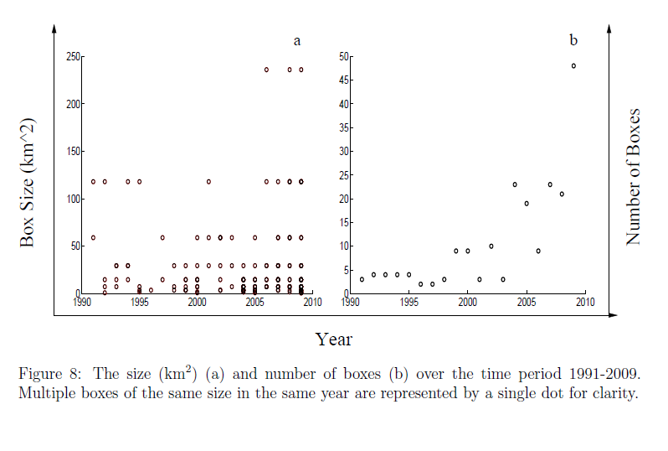
Presenting Pictures (Ick)

Slide 81
Presenting Pictures
A picture is worth 10³ words
is there a diagram or figure which makes your point?
A picture sticks
But it doesn’t speak for itself!
Detailed, explanatory captions help immensely
figures come loose from text in publication (and are generally placed to maximize irritation)
many reviewers look at pictures before reading text
many readers only look back for the pictures

Slide 82
Presenting Pictures
Don’t assume the text will carry the picture
Do tell the reader everything necessary to interpret the picture, and what point she should get from the figure

Slide 83
Presenting Pictures
Don’t assume the text will carry the picture
Do tell the reader everything necessary to interpret the picture, and what point she should get from the figure
In the text:
“As you can see in Figure 8 the size of the domains we used grew in the last five years.”

Slide 84
Presenting Pictures
Don’t assume the text will carry the picture
Do tell the reader everything necessary to interpret the picture, and what point she should get from the figure
In the text:
“As you can see in Figure 8 the size of the domains we used grew in the last five years.”

Slide 85
Presenting Pictures
Don’t assume the text will carry the picture
Do tell the reader everything necessary to interpret the picture, and what point she should get from the figure
In the text:
“As you can see in Figure 8 the size of the domains we used grew in the last five years.”
“The size and number of domains we used for local analysis grew from 2000 to 2010 (Fig. 8) as the death-weasels expanded their range.”

Slide 86
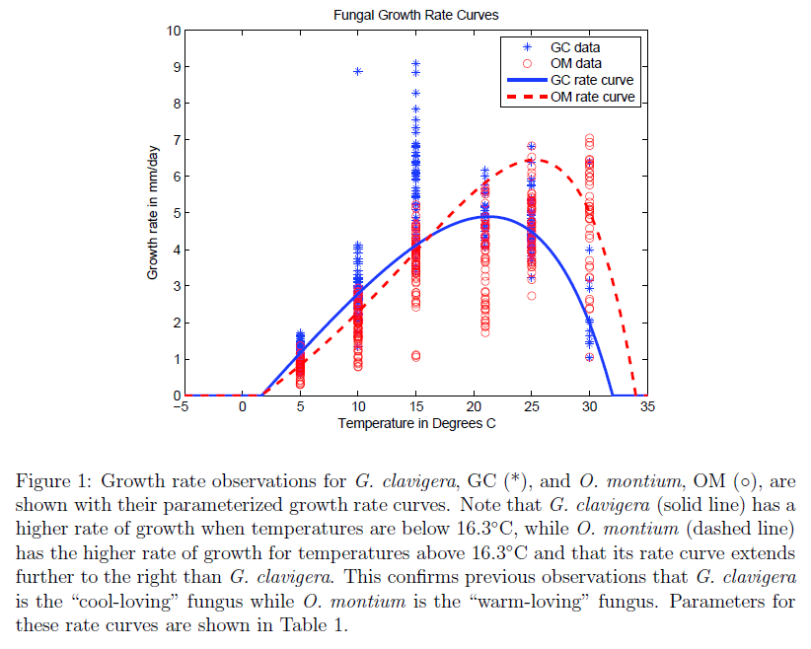
Presenting Pictures

Slide 87
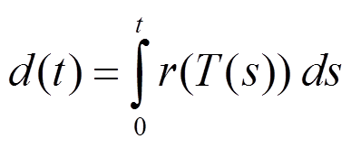
Presenting Pictures
And in the text:
“Total distance, d(t), colonized by a fungus in a thermal environment with temperatures T(t) can be calculated by integrating the rate curve, r(T),
for each species. The `cool’ fungus, Clavigera, has higher rates at temperatures below 16.3ºC, while the `warm’ fungus, Montium, grows faster above 16.3ºC (Fig. 1).”

Slide 88
Tightening Sentences
Cicero:
“When you wish to instruct, be brief; that men’s minds take in quickly what you say, learn its lesson, and retain it faithfully. Every word that is unnecessary only pours over the side of a brimming mind.”

Slide 89
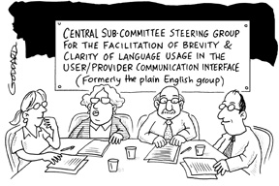
Tightening Sentences
Cicero:
“When you wish to instruct, be brief; that men’s minds take in quickly what you say, learn its lesson, and retain it faithfully. Every word that is unnecessary only pours over the side of a brimming mind.”
Einstein:
“If you can’t say it simply
you probably don’t
understand it.”

Slide 90
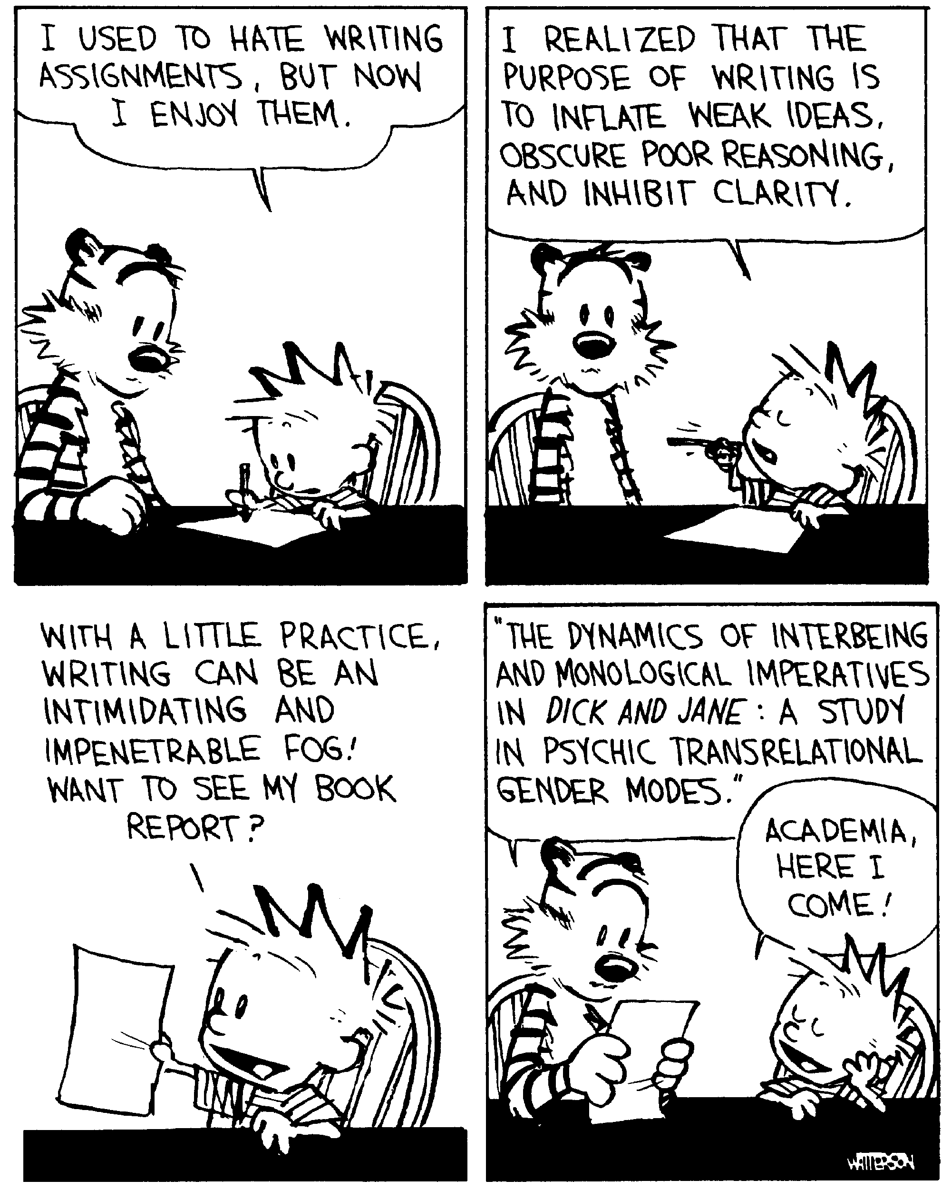
Tightening Sentences
Cicero:
“When you wish to instruct, be brief; that men’s minds take in quickly what you say, learn its lesson, and retain it faithfully. Every word that is unnecessary only pours over the side of a brimming mind.”
Einstein:
“If you can’t say it simply you probably don’t understand it.”

Slide 91
Tightening Sentences
From a student paper in my biomath class:
“This paper will concentrate on the modeling of yeast. Yeast has been highly studied throughout history because of the advantages of its characteristics such as being unicellular and the ability to be grown on defined media which allows complete control over environmental parameters for the investigator.”

Slide 92
Tightening Sentences
From a student paper in my biomath class:
“This paper will concentrate on the modeling of yeast. Yeast has been highly studied throughout history because of the advantages of its characteristics such as being unicellular and the ability to be grown on defined media which allows complete control over environmental parameters for the investigator.”
Tighter:
“Yeast has been studied extensively because it is unicellular and grows on simple media, giving researchers control over environmental parameters.”

Slide 93
Incisive Writing
Orwell’s 6 Rules for Writers:
If it is possible to cut out a word, cut it out.
Never use a long word where a short word will do.
Never use a passive when you can use an ACTIVE.
Never use a foreign phrase, scientific word, or jargon if you can think of an everyday English equivalent.
Never use a metaphor, simile or figure of speech that you are used to seeing in print.
Break any of these rules sooner than saying anything outright barbarous.

Slide 94
Tightening Sentences
From a paper on project-based teaching:
“Learning not only the basics of a model, but how its creation came to be allows students to gain skills in putting together their own models with the knowledge they already possess juxtaposed with the knowledge that they are currently learning.”

Slide 95

Tightening Sentences
From a paper on project-based teaching:
“Learning not only the basics of a model, but how its creation came to be allows students to gain skills in putting together their own models with the knowledge they already possess juxtaposed with the knowledge that they are currently learning.”

Slide 96
Tightening Sentences
From a paper on project-based teaching:
“Learning not only the basics of a model, but how its creation came to be allows students to gain skills in putting together their own models with the knowledge they already possess juxtaposed with the knowledge that they are currently learning.”
How would you improve this?

Slide 97
Punchy Paragraphs
First draft, summary paragraph from a paper
An experiment monitoring yeast growth with sugar limitations is a lab that can assist students in gaining a better understanding of population dynamics and limited resources whilst gaining experience with model creation and working with hard data. In this paper I will discuss results of an experimental lab to understand student reaction and achievement in a math biology course. Methods for data collection and lab execution are explained along with starting instruction and introduction of the logistic equation. Experiments are bound to produce data that does not always comply with expected results. Two sets of experimental data, one with unexpected results and the other with more probable data, will be compared. Models created by students will be given and discussed. The goal of this lab is to expose math and biology students to experimental processes and model creation with parameter estimation in hopes to provide them with experience in their field and ignite excitement and knowledge of applied mathematics and biology.

Slide 98
Punchy Paragraphs
Next draft, summary paragraph from a paper
In this paper I discuss student outcomes from a biomathematics lab used to teach modeling and parameter estimation. The lab is launched with an introduction to yeast growth and data collection methods; a derivation of the logistic equation illustrates modeling and parameterization tools. We present two sets of student observations along with models constructed by student groups. One set of `failed' observations spurred the students to develop novel models and estimate unexpected parameters. The challenge of beating the logistic model (and describing the unexpected data) exposed students to the scientific process, built their excitement and confidence in modeling, and helped them see how parameters connect models to data.

Slide 99
Titillating Titles
Typical Math Titles:
“Pfaffian L-ensembles related to the z-measures on partitions with the Jack parameters1/2 or 2.”
“K₁ of a p-adic group ring II.
The determinantal kernel SK₁”

Slide 100
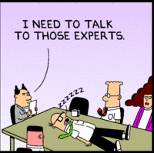
Titillating Titles
Typical Math Titles:
“Pfaffian L-ensembles related to the z-measures on partitions with the Jack parameters1/2 or 2.”
“K₁ of a p-adic group ring II.
The determinantal kernel SK₁”

Slide 101
Titles should
Describe the work
so that reasonable Googling will find your paper

Slide 102
Titles should
Describe the work
so that reasonable Googling will find your paper
Include major findings and conclusions
so audience can decide whether or not to read

Slide 103
Titles should
Describe the work
so that reasonable Googling will find your paper
Include major findings and conclusions
so audience can decide whether or not to read
Capture audience attention
so that your paper stands out

Slide 104
Titles should
Describe the work
so that reasonable Googling will find your paper
Include major findings and conclusions
so audience can decide whether or not to read
Capture audience attention
so that your paper stands out
Be memorable
so readers remember and easily refer to your work

Slide 105
Titillating Titles
Typical Math Titles:
“Pfaffian L-ensembles related to the z-measures on partitions with the Jack parameters1/2 or 2.”
“K₁ of a p-adic group ring II. The determinantal kernel SK₁”
Good Titles:
“Is the null-graph a pointless concept?”
“Kink, twist and writhe: Helical perversion describes tendril growth.”

Slide 106
Improving Titles
AFTER reading the paper
what are key words for the paper subject?
what are key words for the major result/insight?

Slide 107
Improving Titles
AFTER reading the paper
what are key words for the paper subject?
what are key words for the major result/insight?
With other readers
everybody write down two titles using the key words
compare, contrast, improve!

Slide 108
Improving Titles
Could this one be better?
“A new method for calculating net reproductive rate from graph reduction with applications to the control of invasive species.”

Slide 109
rubric for Review

Slide 110
Why a Rubric (and why a writing workshop)?
It isn’t clear to students what we are looking for
and having a review rubric helps to clarify

Slide 111
Why a Rubric (and why a writing workshop)?
It isn’t clear to students what we are looking for
and having a review rubric helps to clarify
It may not be clear to us what we are looking for!
particularly when we are stressed out and reading the n^{th} draft of something

Slide 112
Why a Rubric (and why a writing workshop)?
It isn’t clear to students what we are looking for
and having a review rubric helps to clarify
It may not be clear to us what we are looking for!
particularly when we are stressed out and reading the n^{th} draft of something
Other students motivate student writers better
a rubric helps student reviewers learn what to look for
a rubric helps the writers know what to write

Slide 113
Reviewing Math Writing (BioMath version)
Rubric constructed for USU’s BioMath Lab Group
Undergrad, Grad, Faculty
Based on review rubric from Biology Department, Bates College (Maine)
Revised using faculty/student input from the BioMath Lab Group
Used for both internal contributions and reading published papers (content and style)

Slide 114
Review Process (Author)
Finish draft a week before
Ideally read out loud at least once
Make sure every participant has the draft 1 week before scheduled discussion
Identify proposed audience to group
Ideally with a specific example
Identify proposed venue
Journal name(s)
Special instructions from Guide for Authors (or other)

Slide 115
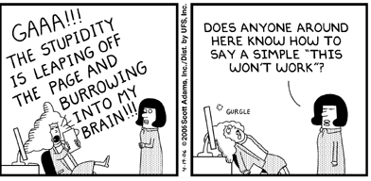
Review Process (Participants)
IS CONFUSING?”

Slide 116
Review Process (Participants)
Read paper through once without comment
Point of paper, overall organization, flow of information
Don’t get stuck in mathematical details
If you are stuck, make a note and keep reading for overall content and exposition

Slide 117
Review Process (Participants)
Read paper a second time. On the paper write specific comments on
Sections/sentences which are well-written and clear
Sections/sentences which are confusing (and what confuses you – descriptive language)
Specific suggestions for reorganization/rewrite to improve communication to designated audience

Slide 118
Review Process (Participants)
Read paper a second time. On the paper write specific comments on
Sections/sentences which are well-written and clear
Sections/sentences which are confusing (and what confuses you – descriptive language)
Specific suggestions for reorganization/rewrite to improve communication to designated audience
Do NOT line-edit entire paper.
For consistent troubles, pick a single instance, mark extensively, note that it is an example

Slide 119
Review Process (the Rubric)
On the review rubric
Assess whether the indicated conventions and info are followed/presented Weakly, Satisfactorily or Strongly
If it is Weak, make sure specific comments are provided for improvement

Slide 120
Review Process (the Rubric)
On the review rubric
Assess whether the indicated conventions and info are followed/presented Weakly, Satisfactorily or Strongly
If it is Weak, make sure specific comments are provided for improvement
When asked for Strong/Weak points provide brief responses upon which the authors can act
Descriptive Language
This is bad, you should say X

Slide 121
Review Process (the Rubric)
On the review rubric
Assess whether the indicated conventions and info are followed/presented Weakly, Satisfactorily or Strongly
If it is Weak, make sure specific comments are provided for improvement
When asked for Strong/Weak points provide brief responses upon which the authors can act
Descriptive Language
This is bad, you should say X
I got lost here, saying X would make it more clear to me

Slide 122
Review Process (the Rubric)
On the review rubric
Assess whether the indicated conventions and info are followed/presented Weakly, Satisfactorily or Strongly
If it is Weak, make sure specific comments are provided for improvement
When asked for Strong/Weak points provide brief responses upon which the authors can act
Descriptive Language
This is bad, you should say X
I got lost here, saying X would make it more clear to me
Saying Y gave me a clear picture of what you did
Nice!

Slide 123
Rubric Example - Introduction
Weak/OK/Strong Criteria:
Purpose/Goal of study clearly stated (Summary ¶)
Motivation/Importance clearly indicated (Penultimate ¶)
Previous research appropriately cited
Logical flow from general to specific ( property)
Brief overview of what will be done (Summary ¶)

Slide 124
Rubric Example - Introduction
Short Responses:
According to author, what is specific purpose of study, and how well does background info educate you as to basis of the work and larger context of the study? Is a case made for the importance of this work?

Slide 125
Rubric Example - Introduction
Short Responses:
According to author, what is specific purpose of study, and how well does background info educate you as to basis of the work and larger context of the study? Is a case made for the importance of this work?
What specific questions/needs are addressed? Have they been made clear?

Slide 126
Rubric Example - Introduction
Short Responses:
According to author, what is specific purpose of study, and how well does background info educate you as to basis of the work and larger context of the study? Is a case made for the importance of this work?
What specific questions/needs are addressed? Have they been made clear?
Identify one or two good/important aspects of the Introduction that should be retained in revision.

Slide 127
Rubric Example - Introduction
Short Responses:
According to author, what is specific purpose of study, and how well does background info educate you as to basis of the work and larger context of the study? Is a case made for the importance of this work?
What specific questions/needs are addressed? Have they been made clear?
Identify one or two good/important aspects of the Introduction that should be retained in revision.
Identify one or two weak aspects of the Introduction that should be corrected in revision.

Slide 128
Conclusion

Slide 129
The Writing Gap
Few examples of good mathematical style

Slide 130
The Writing Gap
Few examples of good mathematical style
Students seldom read math for style
cushioning equations
presenting figures

Slide 131
The Writing Gap
Few examples of good mathematical style
Students seldom read math for style
cushioning equations
presenting figures
Students have far less experience with technical English now than 30 years ago
outlining/summarizing
tight writing
basic essay formats
writing/reading in classes

Slide 132
To Help Students Write Effectively
Provide a clear vision of a math paper’s functional structure

Slide 133
To Help Students Write Effectively
Provide a clear vision of a math paper’s functional structure
Provide a rubric for reading and reviewing math papers for style

Slide 134
To Help Students Write Effectively
Provide a clear vision of a math paper’s functional structure
Provide a rubric for reading and reviewing math papers for style
Introduce SUCCES(s)ful writing tactics
Simple
Unexpected
Concrete
Credible
Emotional
Storie(s)

Slide 135
Writing Model for Students
Summary Paragraph – Simplest form of the Message, Unexpected results, and what Credible Story will be told
Thing 1
Thing 2
One is Red, One is Blue

Slide 136
Writing Model for Students
Summary Paragraph – Simplest form of the Message, Unexpected results, and what Credible Story will be told
Thing 1
Thing 2
One is Red, One is Blue
(Summary)⁻¹ – the Simple message, the Unexpected result why it’s Credible

Slide 137
Writing Model for Students
Penultimate Paragraph – What is
the (Unexpected) gap in knowledge?
Summary Paragraph – Simplest form of the Message, Unexpected results, and what Credible Story will be told
Thing 1
Thing 2
One is Red, One is Blue
(Summary)⁻¹ – the Simple message, the Unexpected result why it’s Credible

Slide 138
Writing Model for Students
Introducing Context – Why should
the audience care (Emotion)?
Penultimate Paragraph – What is
the (Unexpected) gap in knowledge?
Summary Paragraph – Simplest form of the Message, Unexpected results, and what Credible Story will be told
Thing 1
Thing 2
One is Red, One is Blue
(Summary)⁻¹ – the Simple message, the Unexpected result why it’s Credible
The impact, consequences and why we
should have an Emotional reaction

Slide 139
Writing Model for Students
Introducing Context – Why should
the audience care (Emotion)?
Penultimate Paragraph – What is
the (Unexpected) gap in knowledge?
Summary Paragraph – Simplest form of the Message, Unexpected results, and what Credible Story will be told
Thing 1
Make the message Concrete:
-well-cushioned equations
-well-presented pictures
-Orwell’s Rules for tight sentences and punchy paragraphs
Thing 2
One is Red, One is Blue
(Summary)⁻¹ – the Simple message, the Unexpected result why it’s Credible
The impact, consequences and why we
should have an Emotional reaction

Slide 140
Writing Model for Students
Introducing Context – Why should
the audience care (Emotion)?
Penultimate Paragraph – What is
the (Unexpected) gap in knowledge?
Summary Paragraph – Simplest form of the Message, Unexpected results, and what Credible Story will be told
Thing 1
Make the message Concrete:
-well-cushioned equations
-well-presented pictures
-Orwell’s Rules for tight sentences and punchy paragraphs
Thing 2
Provide
Credible
support
One is Red, One is Blue
(Summary)⁻¹ – the Simple message, the Unexpected result why it’s Credible
The impact, consequences and why we
should have an Emotional reaction

Slide 141
Writing Model for Students
Introducing Context – Why should
the audience care (Emotion)?
Penultimate Paragraph – What is
the (Unexpected) gap in knowledge?
Summary Paragraph – Simplest form of the Message, Unexpected results, and what Credible Story will be told
Thing 1
Make the message Concrete:
-well-cushioned equations
-well-presented pictures
-Orwell’s Rules for tight sentences and punchy paragraphs
Tell the Story
Thing 2
Provide
Credible
support
One is Red, One is Blue
(Summary)⁻¹ – the Simple message, the Unexpected result why it’s Credible
The impact, consequences and why we
should have an Emotional reaction

