Slide 1


GASRATS Merit Review
Presented by: Carter Page, Tyler Day, Bella Nielsen
Date: September 23, 2023
Notes:
Carter Page, Team Coordinator
Tyler Day, Lead Payload Engineer
Bella Nielsen, Outreach Director

Slide 2
Presentation Overview
GAS Team Overview
GASRATS Overview
NASA’s CSLI
Educational Merit
Technological Merit
Conclusion
Q&A

Slide 3
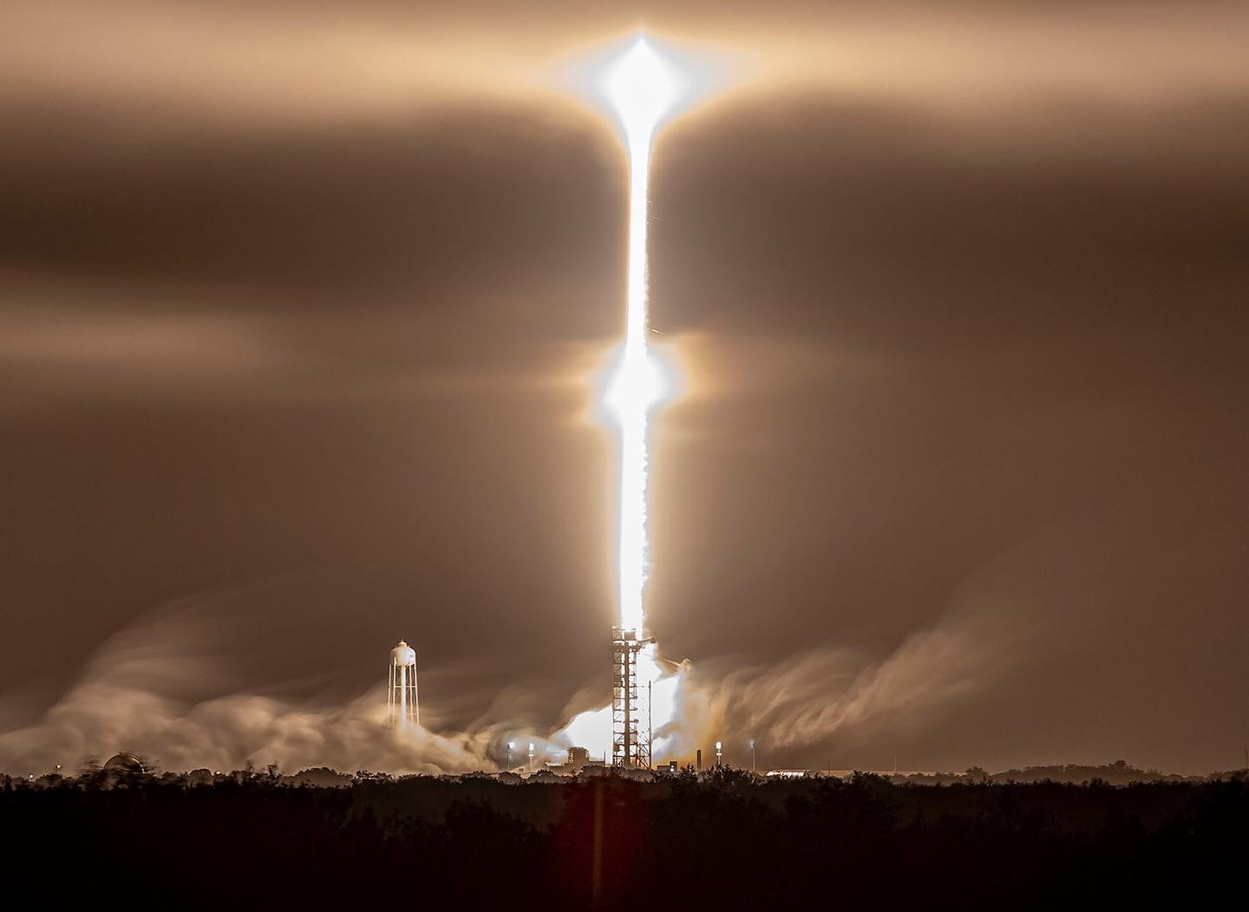
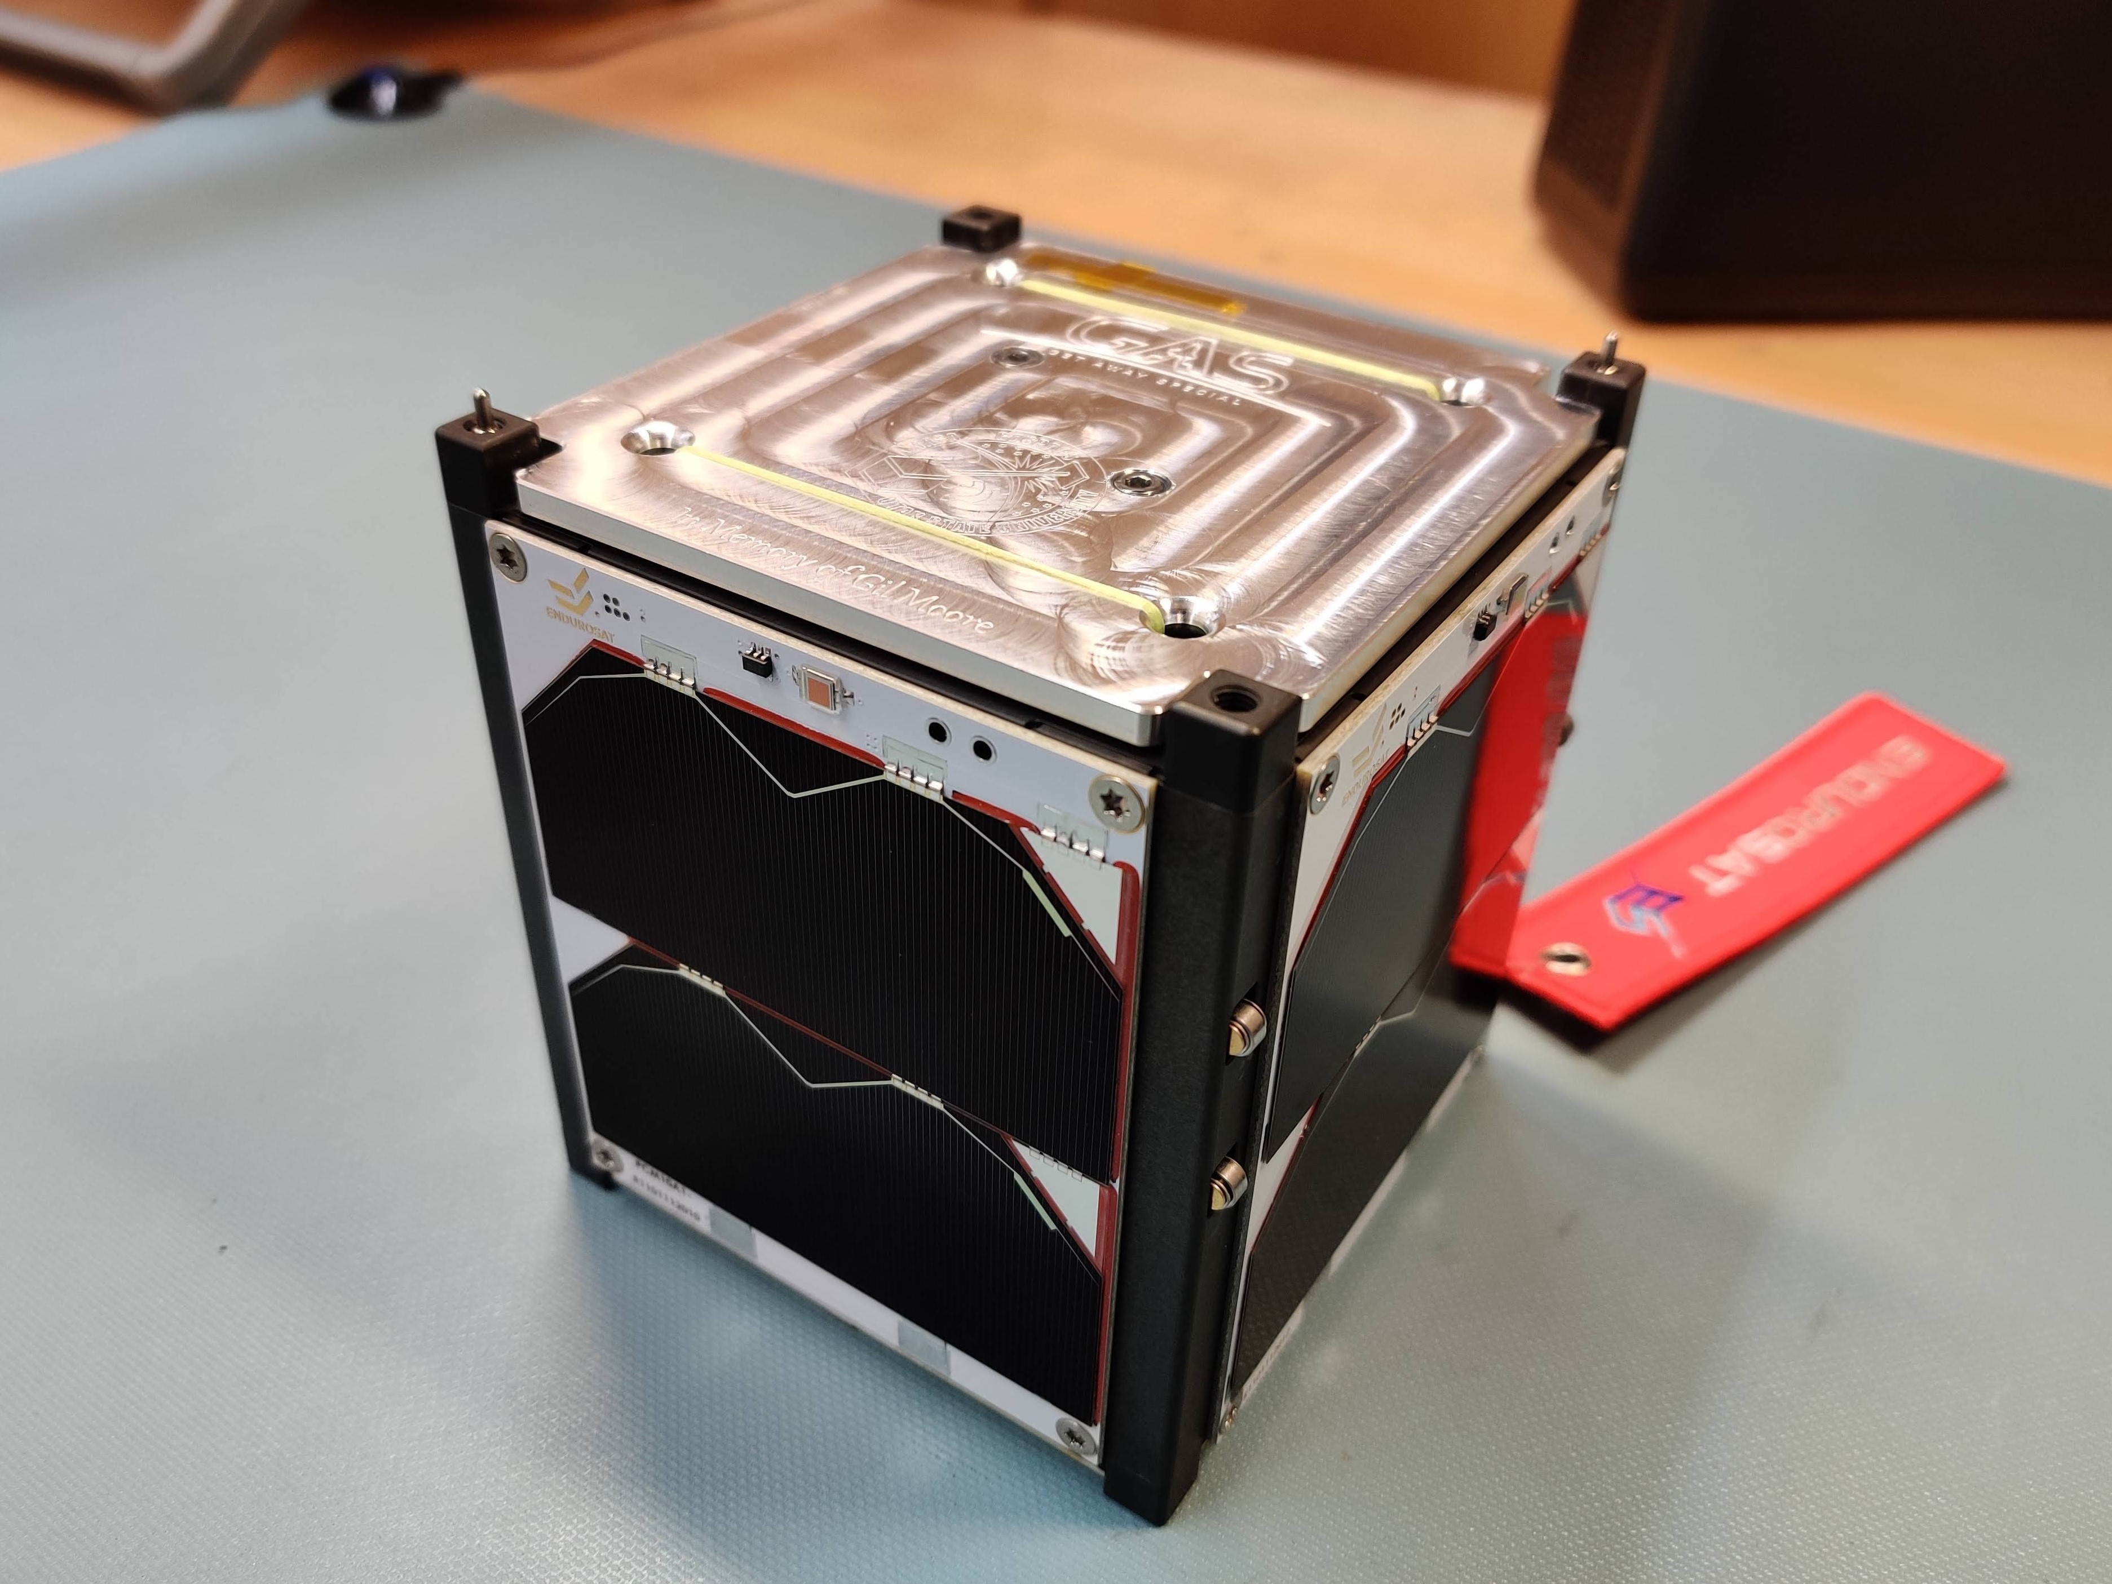
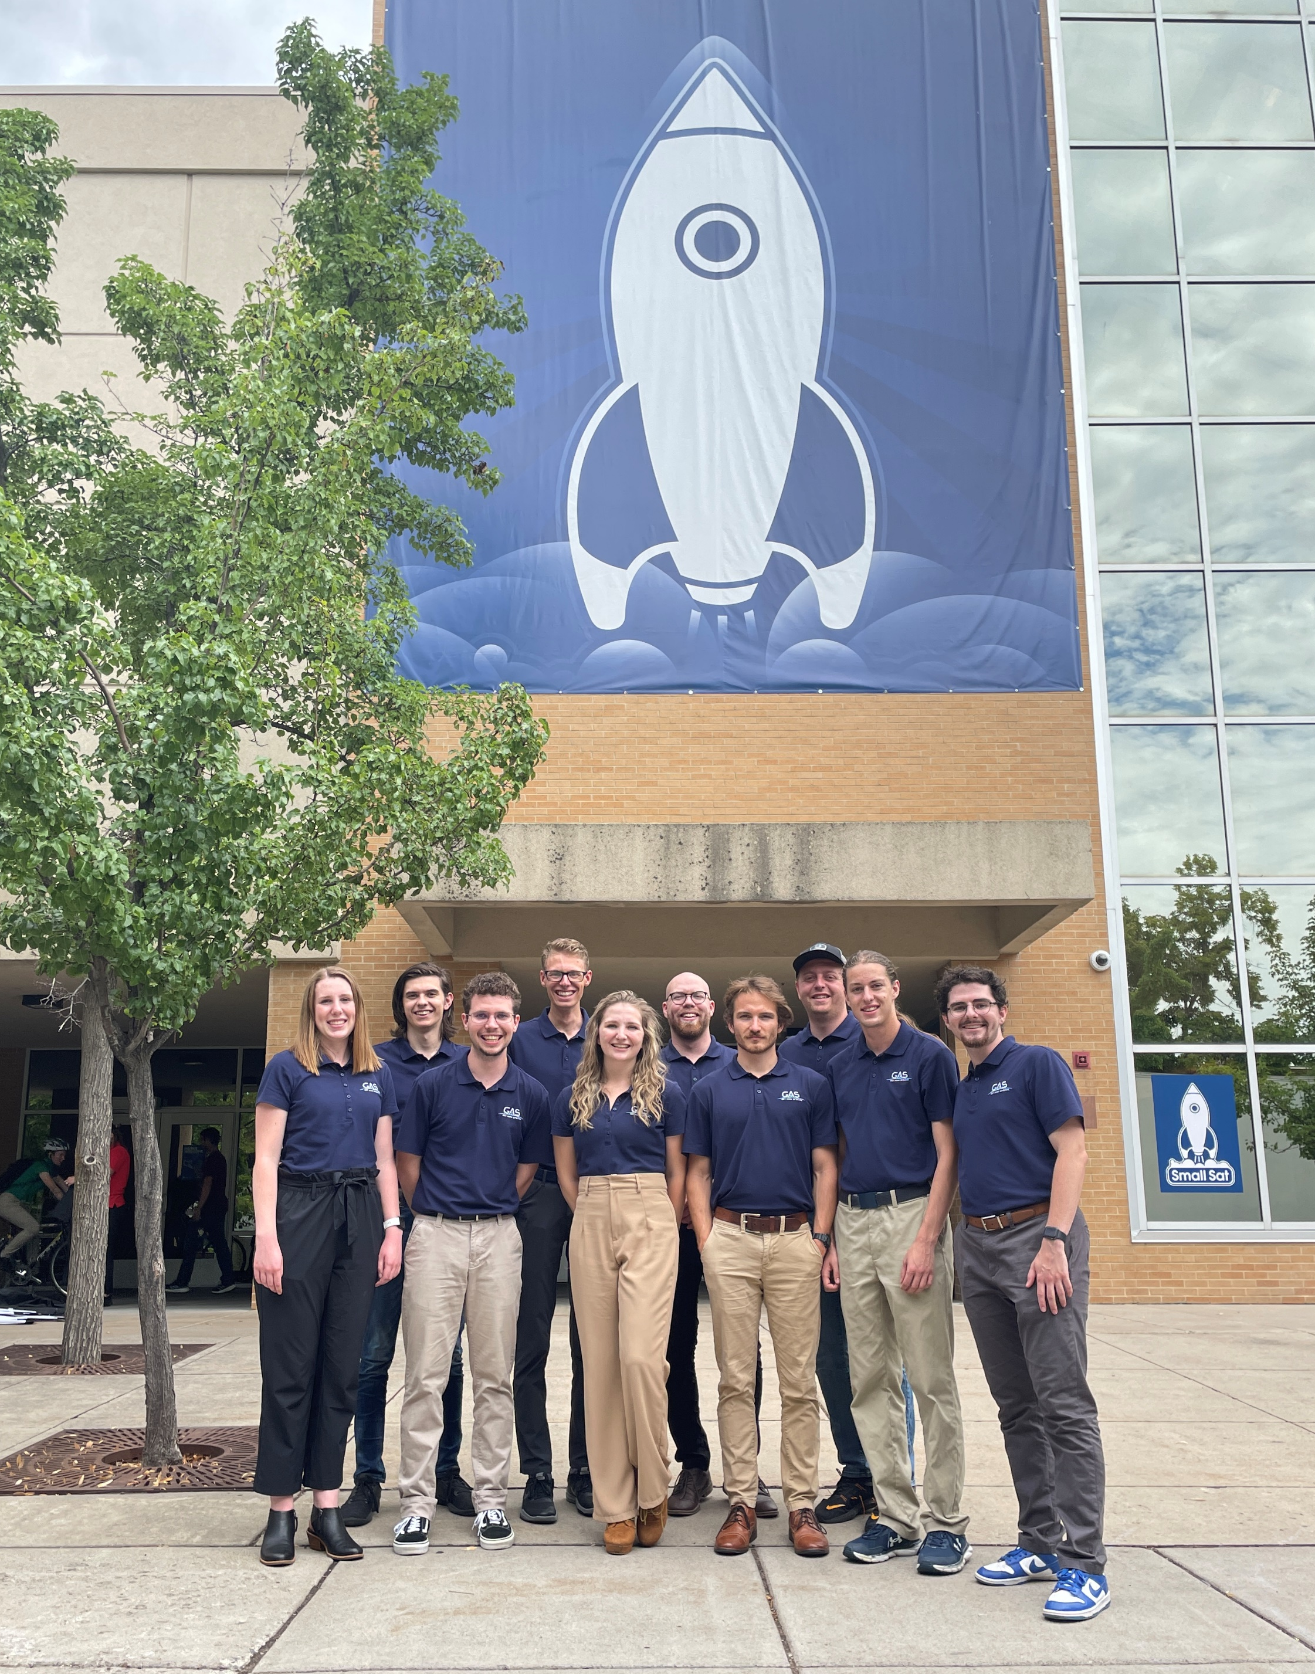
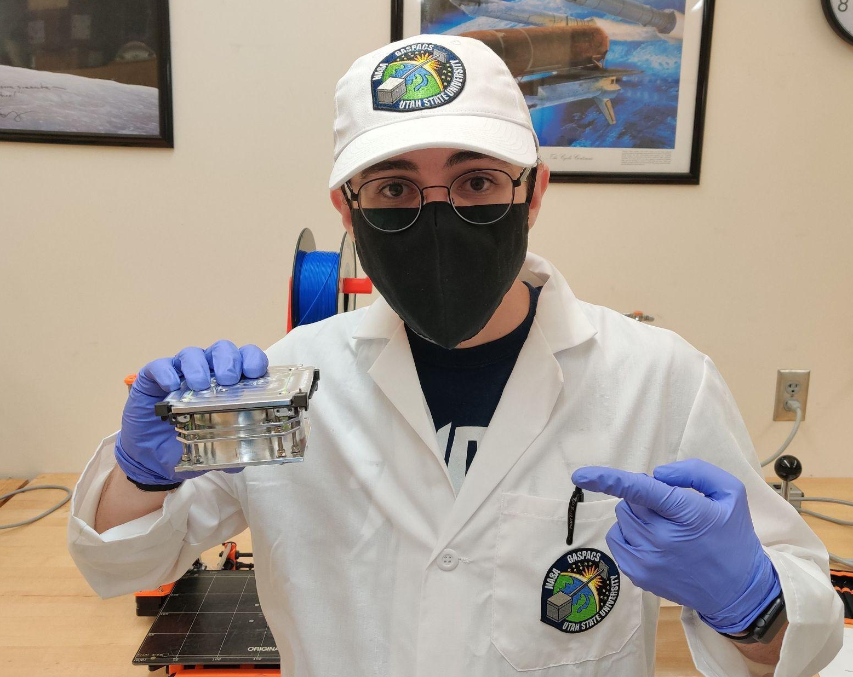
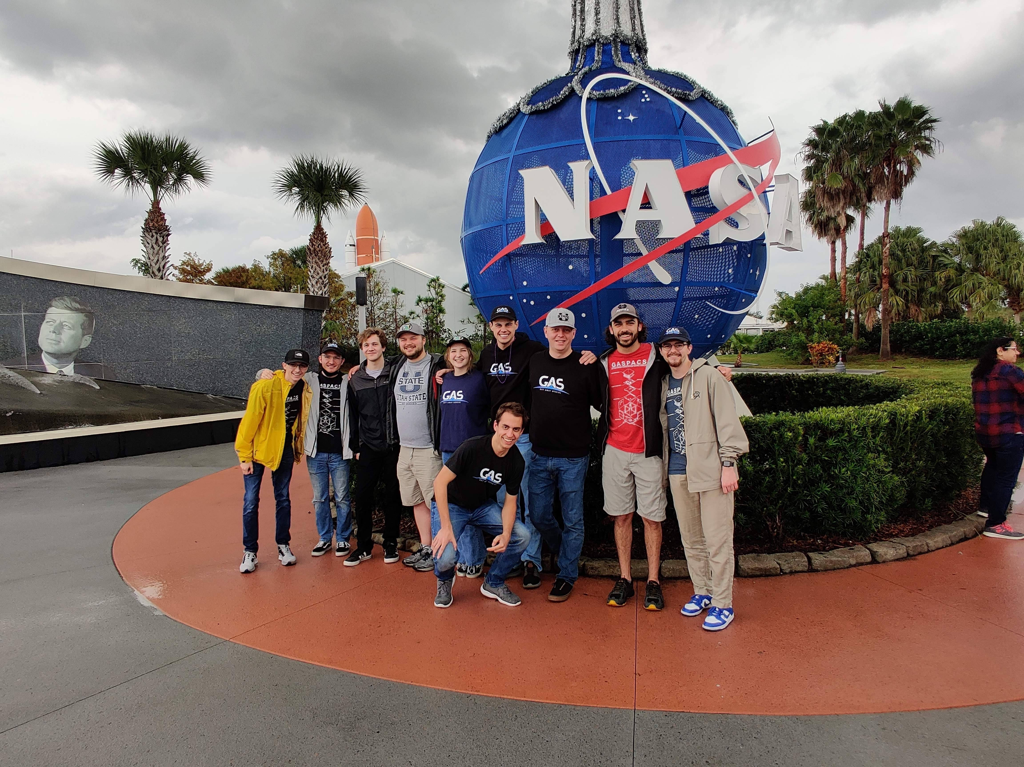
What is the GAS Team?
The Get Away Special (GAS) Student Satellite Team is a student-run team at USU focused on designing and building CubeSats!
Notes:
The USU GAS Team began in 1976 when aerospace legend Gil Moore purchased and donated the first payload of NASA’s Get Away Special program to USU, which flew on STS-4 in 1982.
NASA’s GAS program allowed universities, companies, and other interested organizations to fly small experiments onboard the Space Shuttle.
The program allowed a cost-effective way for small experiments to get to space. Price examples: $3,000 for 60 lbs, $5,000 for 100 lbs, and $10,000 for 200 lbs.
USU’s GAS Team flew 11 payloads (“GAS Cans”) through NASA’s GAS program before the program was canceled after the Columbia disaster in 2003.
The USU GAS Team was then left without a way to space. For the next 10 years, the team performed their experiments in a variety of ways, including microgravity flights on the “Vomit Comet” and high-altitude balloon flights.
Eventually, the team shifted to CubeSats and began GASPACS, a 1U CubeSat, in 2013.
GASPACS launched to the ISS in December 2021 and was then deployed into space in January 2022, lasting 117 days in space before deorbiting in May 2022.
GASPACS was an incredible success and accomplished many feats, most notably becoming the first completely undergraduate CubeSat and the first satellite to use a Raspberry Pi as the main flight computer.
Now, the team is taking what it learned from GASPACS to begin the next CubeSat, GASRATS.

Slide 4
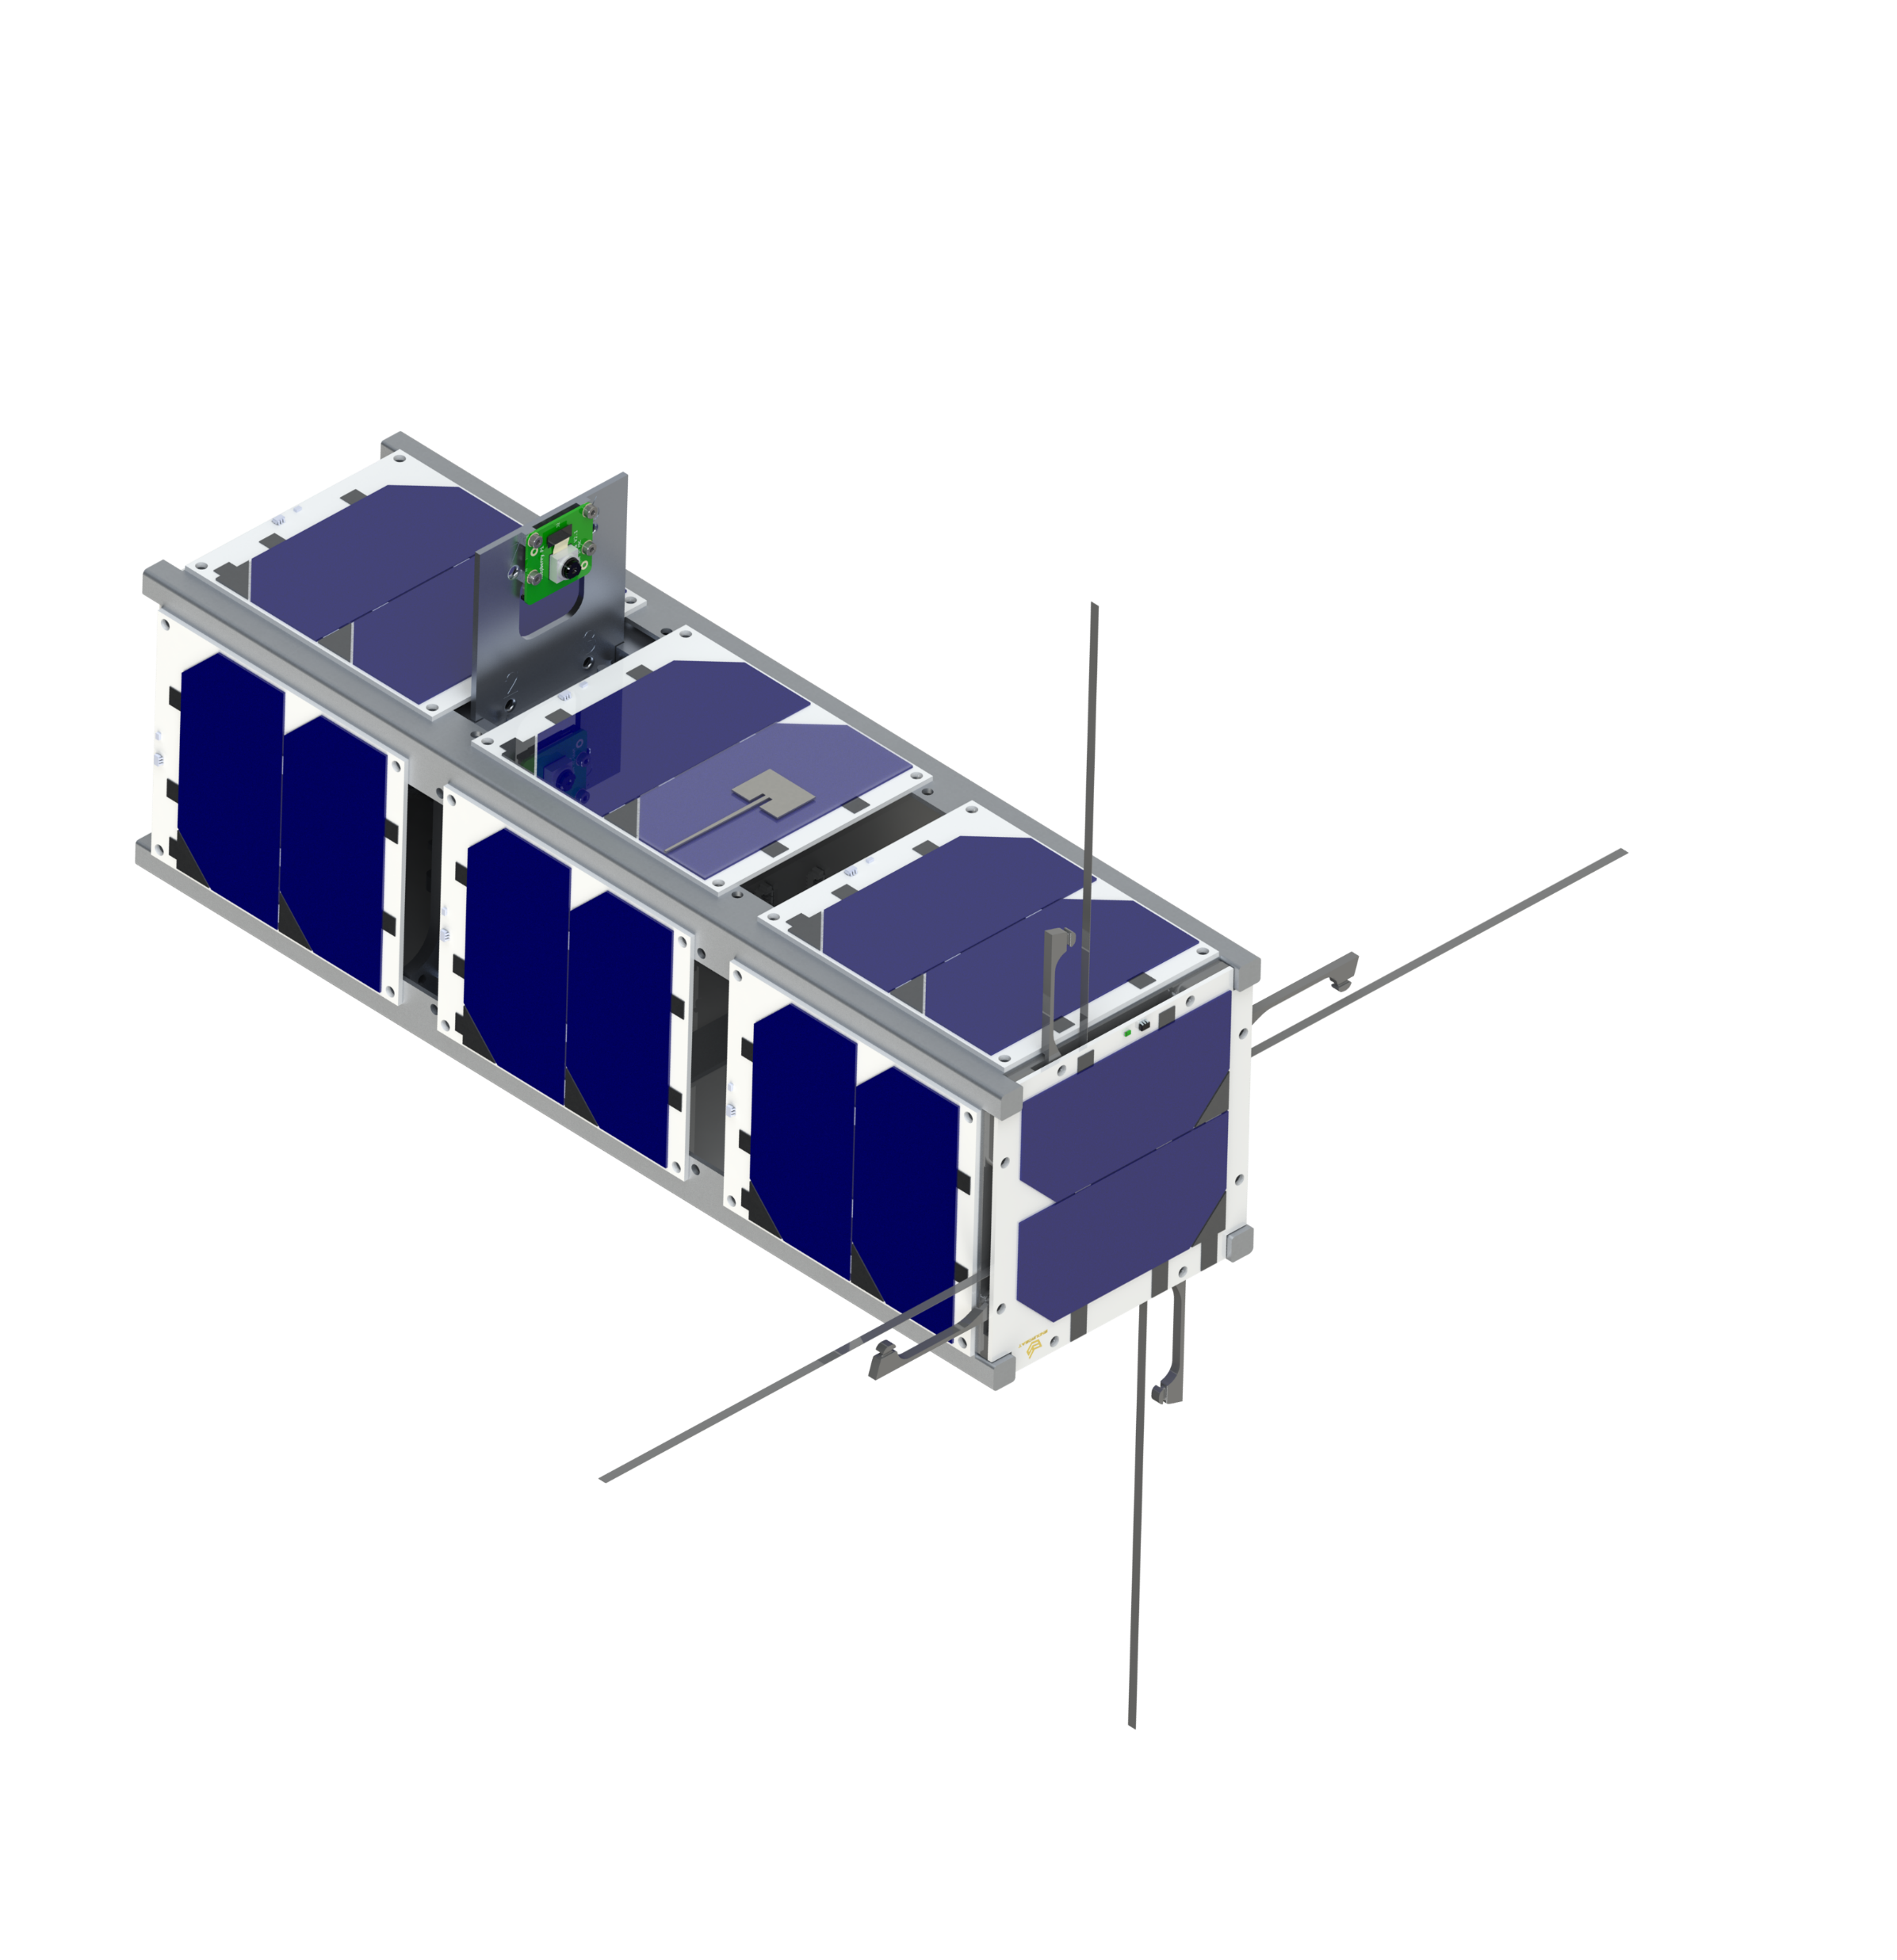

GASRATS Overview
Get Away Special Radio and Antenna Transparency Satellite
3U CubeSat
Provide educational opportunities for GAS Team and others
Demonstrate transparent patch antenna technology
Collaboration with USU ECE Professor, Dr. Reyhan Baktur
Unofficial GASRATS Patch Mock-Up
Notes:
The Get Away Special Radio and Antenna Transparency Satellite (GASRATS) is a 3U CubeSat educational and technology demonstration mission.
Primary focus of the mission is to educate and inspire students about space. This will be achieved two ways:
The project will give students on the GAS Team the opportunity to directly design, build, and operate a satellite that goes to space. The GAS Team’s unique team structure has the students making nearly every project decision, allowing learning opportunities and experiences that will launch them into their future career.
GASRATS will feature an educational outreach program, titled Bring Utah Students to Space (BUSS). BUSS aims to involve K-12 students across Utah in the mission, offering the opportunity to fly their name on the satellite. More on this later in the presentation.
Secondary focus of the mission is technology demonstration. The GAS Team is collaborating with Dr. Reyhan Baktur, a professor within USU’s ECE Department whose studies are focused on CubeSat antenna design. The team is working with Dr. Baktur to design and fly an optically transparent, solar panel-integrated S-band patch antenna. This technology has never flown before and could prove to be incredibly beneficial to future CubeSat missions. More on this later in the presentation.
Although launch is dependent on many things, such as NASA schedules, the GAS Team anticipates completion of GASRATS in Summer 2025 and a launch in late 2025 or early 2026.

Slide 5

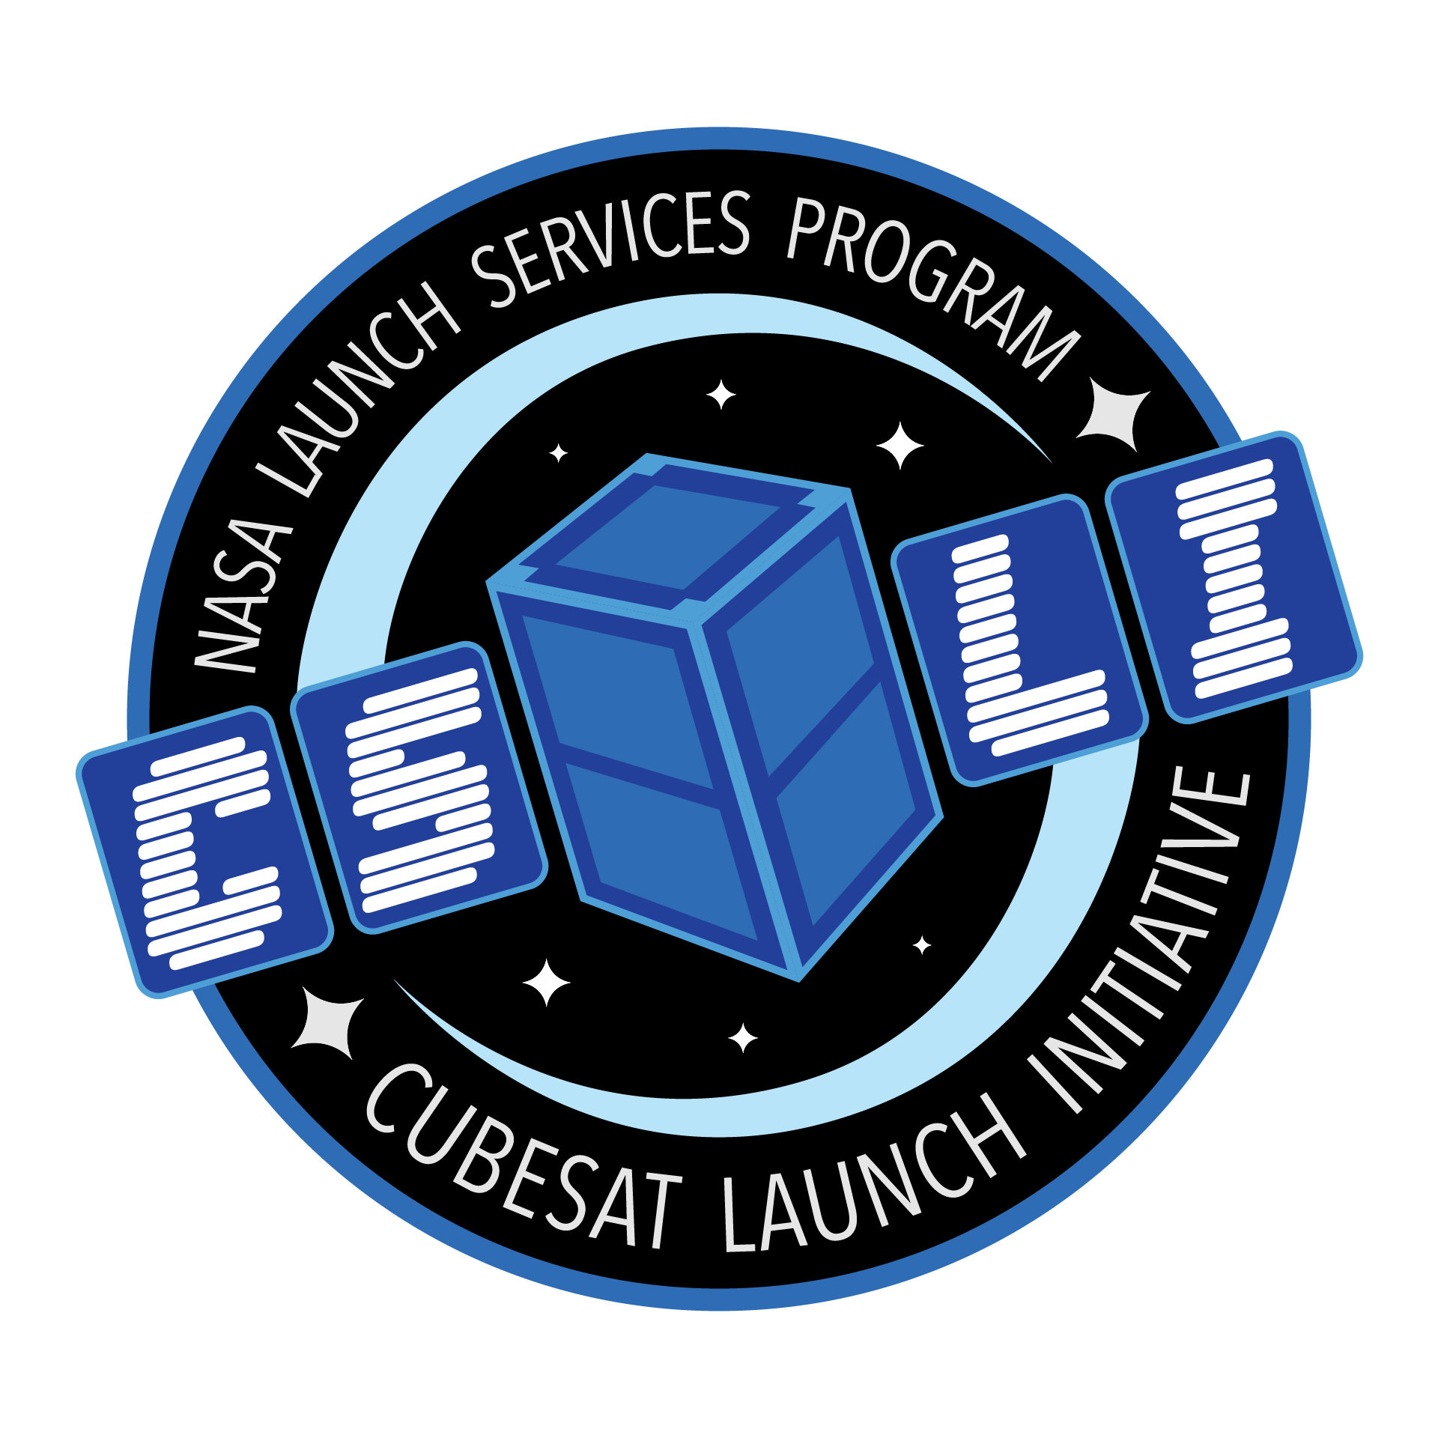
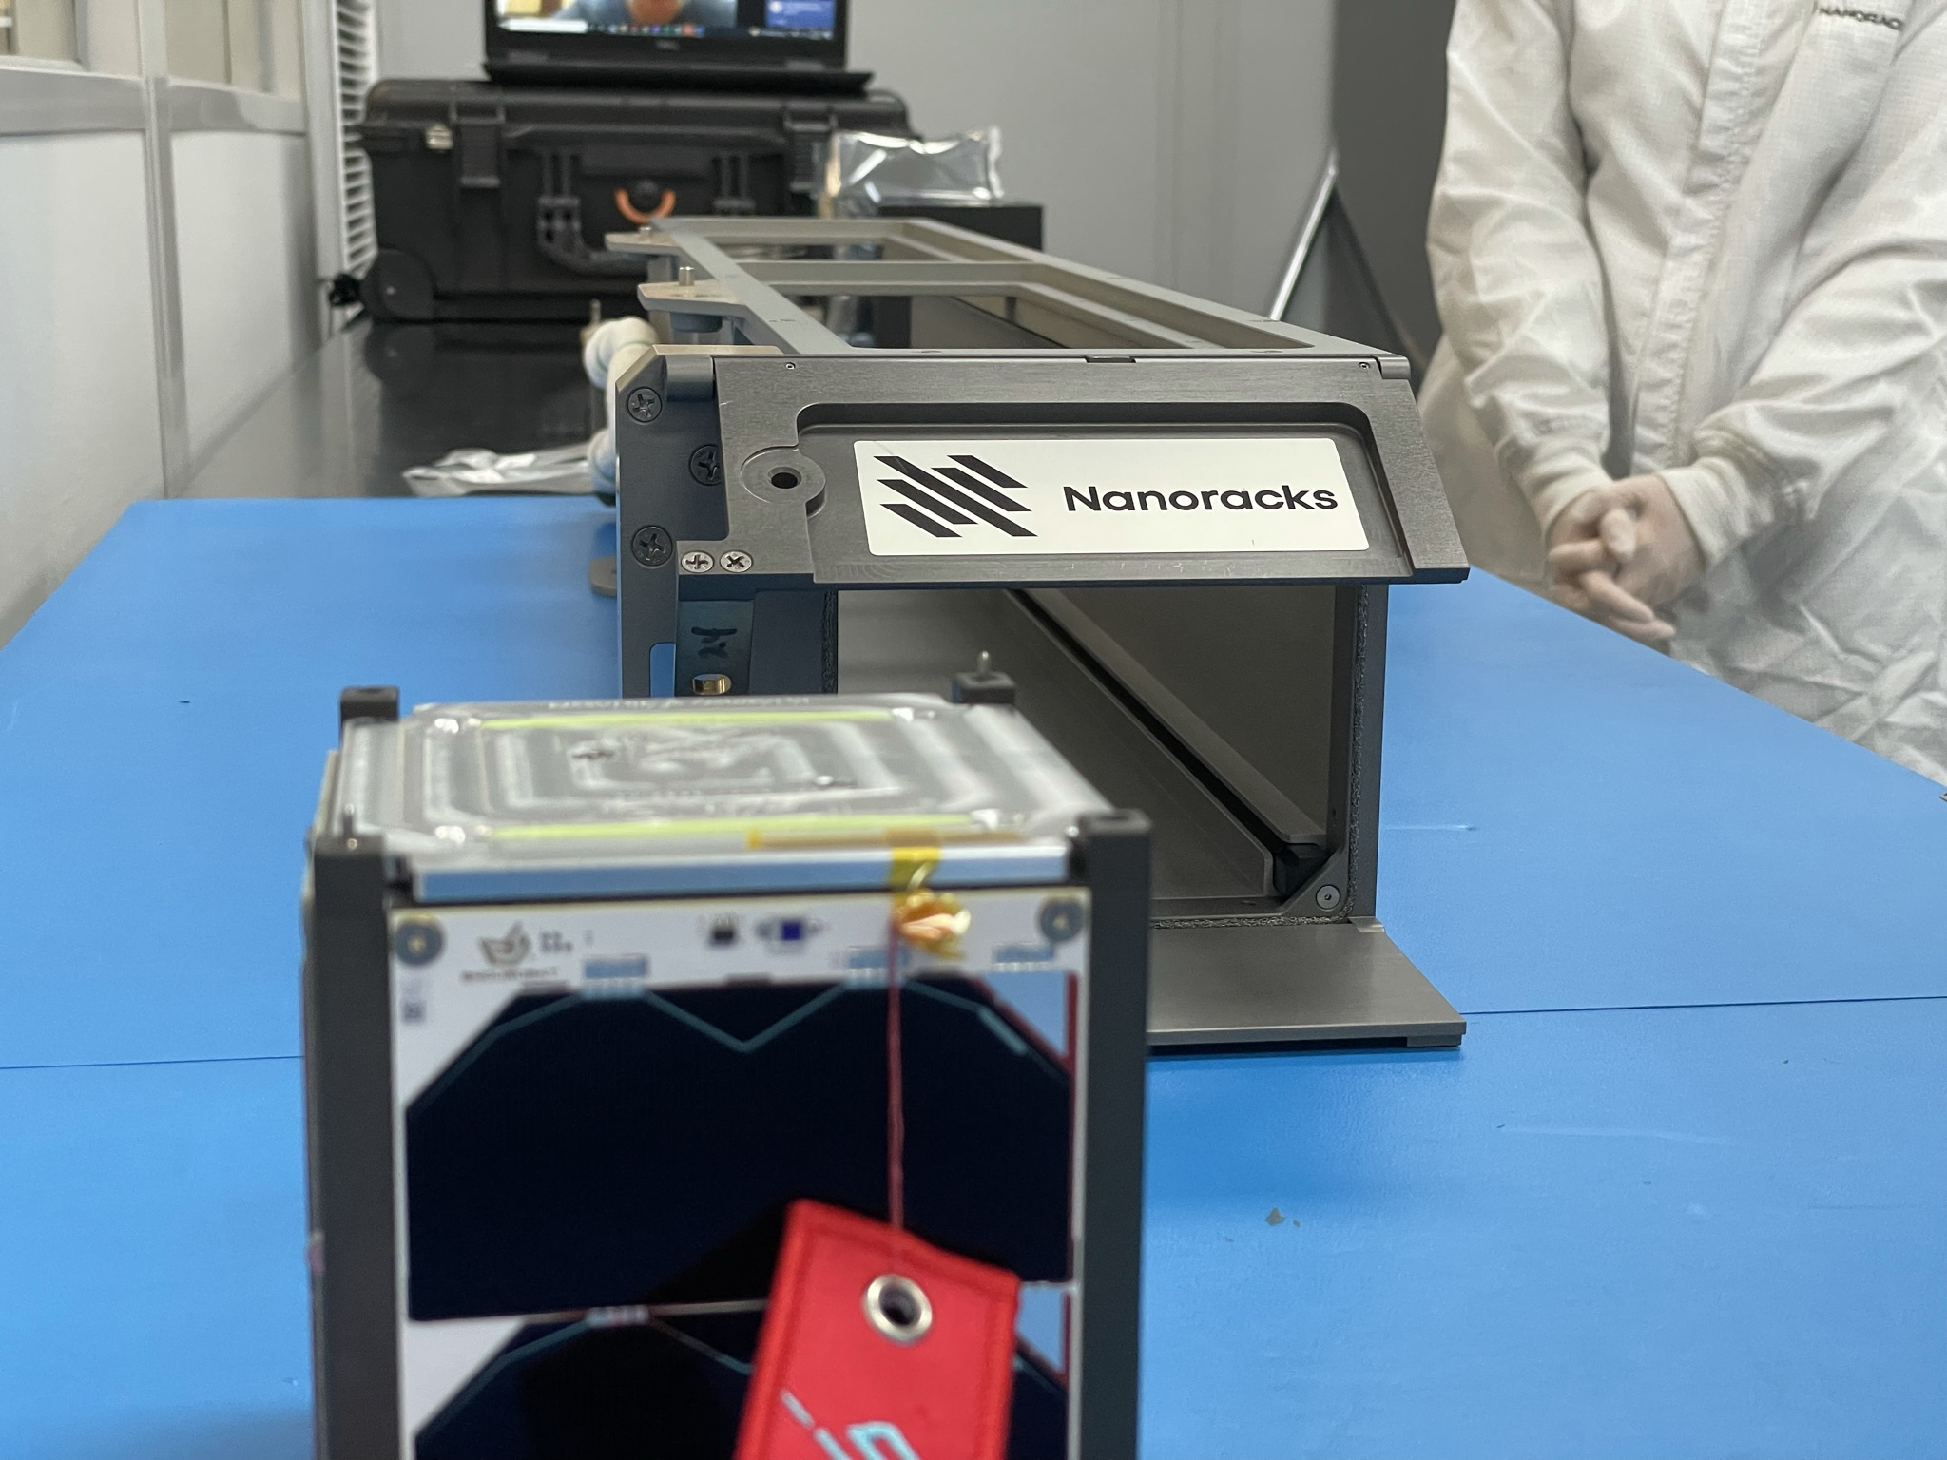

NASA’s CSLI
CubeSat Launch Initiative (CSLI)
Provides U.S. educational institutions a way to space
Pays entirely for launch (up to $300k)
Must meet at least one of three criteria:
Education
Technology
Science
Required to hold two external reviews:
Merit
Feasibility
Notes:
NASA’s CubeSat Launch Initiative (CSLI) is run by the Launch Services Program at Kennedy Space Center.
Yearly opportunities for educational institutions and non-profit organizations to apply and secure a way to space.
Pays for the launch up to $300k. Since we’re doing 3U, we should stay under this price.
For educational institutions, CubeSat missions must have a primary focus on education. A secondary focus on technology demonstration or science is encouraged. We’re doing education and technology.
Proposers can request any orbit, though ISS (400 km) is most awarded due to ISS resupply missions. We will request ISS orbit.
We flew through CSLI for GASPACS, so have some experience with CSLI already.
Applied last year and was rejected due to insufficient details in our proposal regarding the required merit and feasibility reviews. We have considered the valuable feedback from last year and feel confident about our refined approach to the reviews and the proposal.

Slide 6
Required Reviews
Merit Review
Educational Quality
Technical Quality
Assist NASA to achieve their goals and objectives
Feasibility Review
Technical Implementation
Feasibility
Resiliency
Risk
Probability of Success
Notes:
The merit and feasibility reviews allow proposal teams to collect feedback that will improve their proposals as well as chances of mission success.
For each review, the review panel will assess the project of the following (listed on slide).
Today, we are conducting the merit review. The GASRATS feasibility review will be held next month on October 28.
We ask that you withhold from asking any technical questions today that you may have. We’d like to keep the merit review meeting focused on how the GASRATS mission aligns with NASA’s goals and objectives. We are willing to answer any technical questions following the merit review over the phone or email, or at the feasibility review in October.

Slide 7
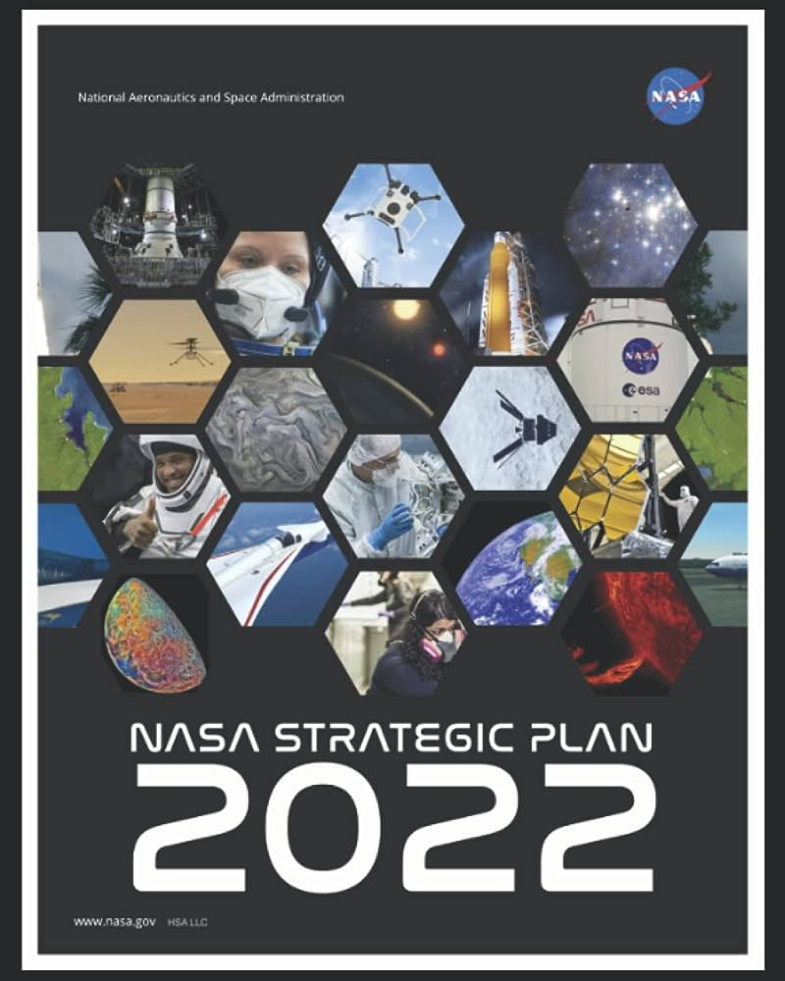
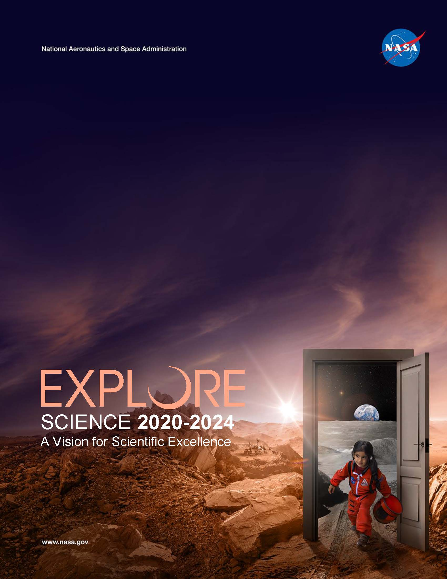
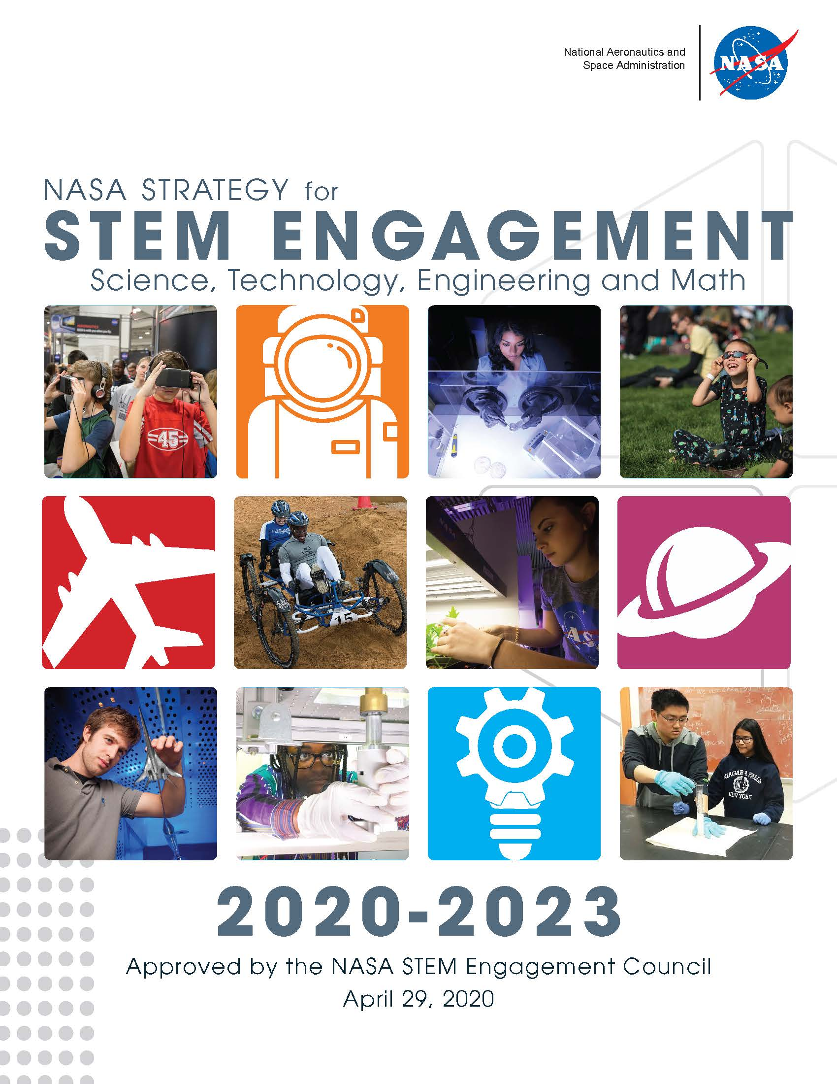
Merit Review
How well does the GASRATS mission align with NASA’s goals and objectives?
Specific goals and objectives selected from NASA strategic documents
Is a launch opportunity necessary to achieve the objectives of the GASRATS mission?
Notes:
According to NASA, “The merit review should determine the educational, scientific, or technical quality of the proposed CubeSat mission and how the mission will assist NASA to achieve the goals and objectives regarding STEM, science, and technology as applicable per the focus area(s) selected.”
The specific goals and objectives are selected by the proposal team. We have selected three for the educational focus and one for the technical focus.
NASA’s goals and objectives are outlined across many strategic documents and plans that are all available for proposal teams to select from. We will be selecting goals and objectives from three of the strategic documents:
NASA Strategic Plan 2022
NASA Strategy for STEM Engagement
Science 2020-2024: A Vision for Scientific Excellence (NASA Science Plan)

Slide 8
NASA Strategic Objectives
Educational
Strategy 4.2
NASA Science Plan
Strategic Objective 1.2
NASA Strategy for STEM Engagement
Strategic Objective 4.3
NASA Strategic Plan
Technical/Technological
Strategic Objective 3.1
NASA Strategic Plan
Notes:
We selected three strategic objectives for the educational focus and one for the technical/technological focus. They will be covered throughout the rest of the presentation, so I will not go into detail here.
The purpose of this review is for the reviewers to assess how well-aligned GASRATS is with each of the selected objectives. Reviewers will be asked to rate 1-5 how well GASRATS aligns with NASA’s goals and objectives, with 1 being “Not at All” aligned and 5 being “Fully” aligned. We have structured the Google Form to follow the presentation structure, which we hope will help the reviewers when submitting their feedback.
Beyond the 1-5 rating, we invite reviewers to provide any and all feedback regarding GASRATS. We would especially appreciate any feedback that would help us strengthen our alignment with NASA’s goals and objectives.
We encourage you to be thinking about feedback and ratings as we progress through the presentation.
Although it would seem logical to put education first, we have decided to put the technological section first. We believe that understanding the technology focus and payload provides important context to the education section.
For the sake of the notes though, I will include descriptions here:
Strategy 4.2 from the NASA Science Plan: Purposefully and actively engage with audiences and learners of all ages to share the story of NASA’s integrated science program.
Strategic Objective 1.2 from the NASA Strategy for STEM Engagement: Create structured and widely-accessible, experiential learning opportunities for students to engage with NASA’s experts and help solve problems that are critical to NASA’s mission.
Strategic Objective 4.3 from the NASA Strategic Plan: Build the next generation of explorers. Engage students to build a diverse future STEM workforce.
Strategic Objective 3.1 from the NASA Strategic Plan: Innovate and advance transformational space technologies. Develop revolutionary, high-payoff space technologies driven by diverse ideas to transform NASA missions and ensure American leadership in the space economy.

Slide 9
Technological Merit
Presented by: Tyler Day, Lead Payload Engineer
Notes:
- Now I will turn the time over to…
- Short introduction of Tyler

Slide 10

Story Time
Power negative
Lack of opportunities for communications
Notes:
-Briefly tell the story of GASPACS
-Touch on how it was a great mission but the thing that would have made it better is if we had more power (were forced to power cycle on and off) and thus more opportunities to transmit
- Transition that into what the two main options for CubeSat antennas are

Slide 11
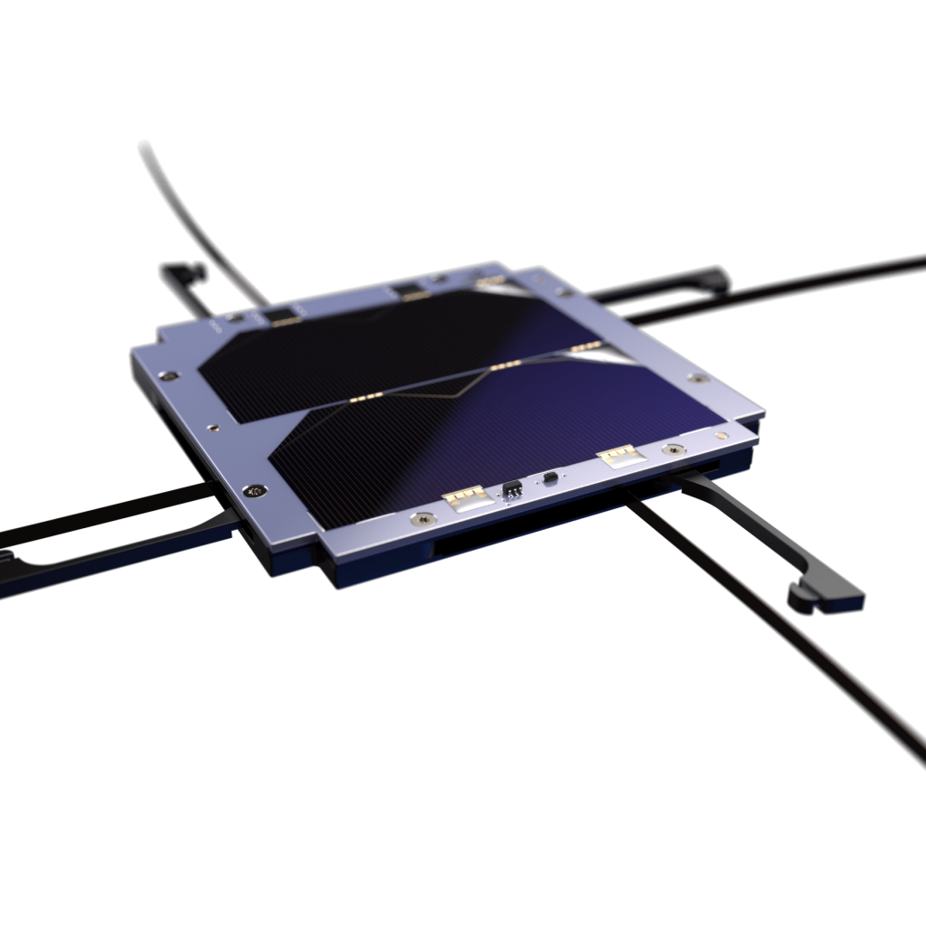
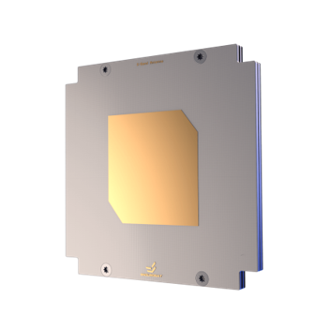
Antennas: What options exist?
UHF deployable antenna
Does not sacrifice power generation
Low data rates
S-band patch antenna
High data rates
Sacrifices power generation
Notes:
- The UHF above is what was flown on GASPACS
- The antenna is integrated with a solar panel, but the data rates are lower
- S-band patches have higher data rates, but they have to take up their own entire place where 2-3 solar cells could be

Slide 12
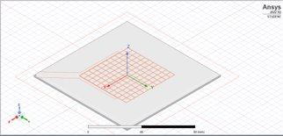
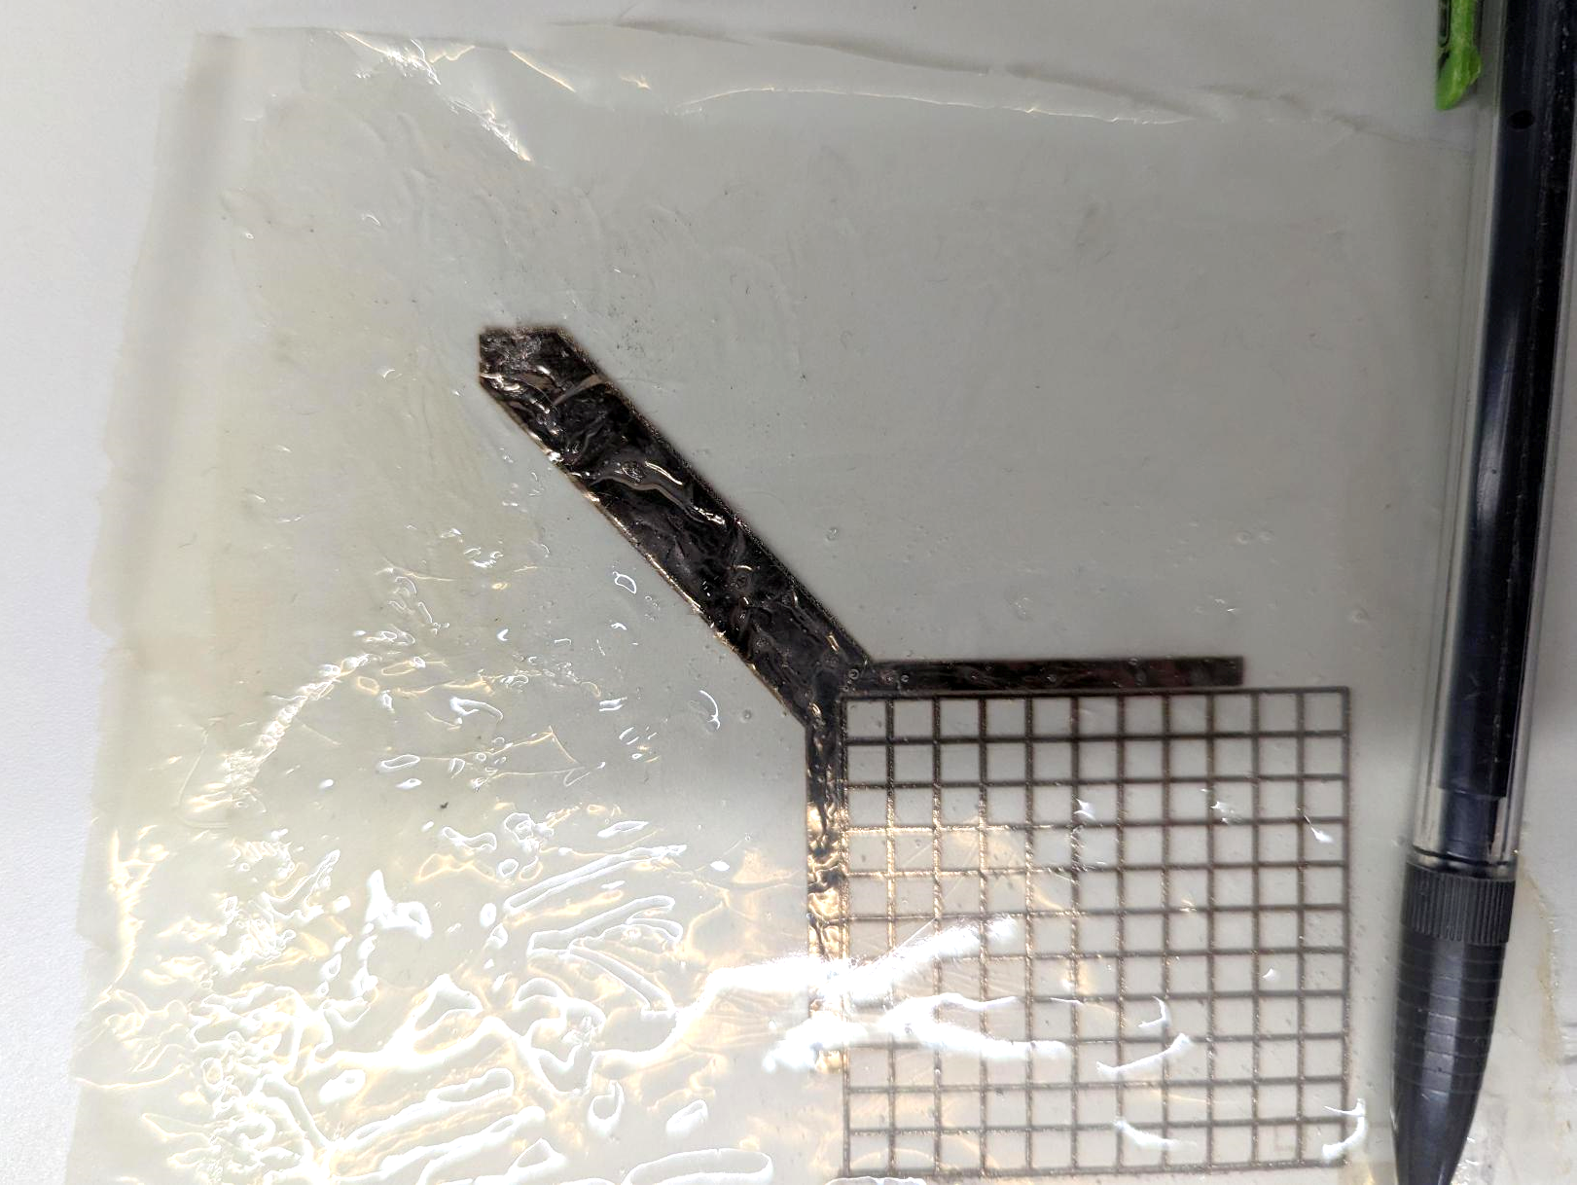

Main Payload
Optically-transparent, solar-panel integrated, S-band patch antenna (TPA)
~90% transparency
Mounted directly above solar panel using custom frame
Printed on a thin polyimide film
Low mass
Low profile

Slide 13
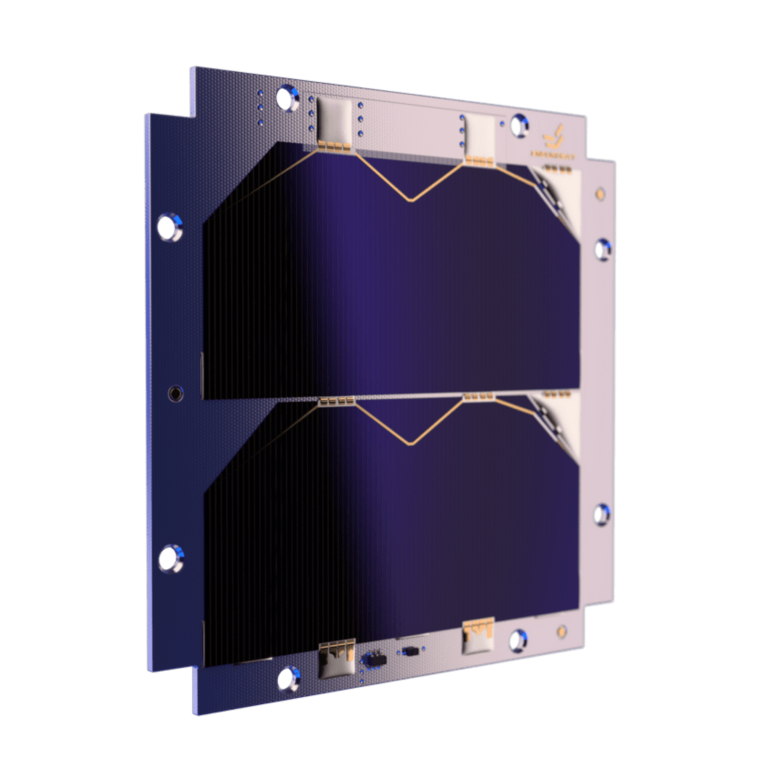

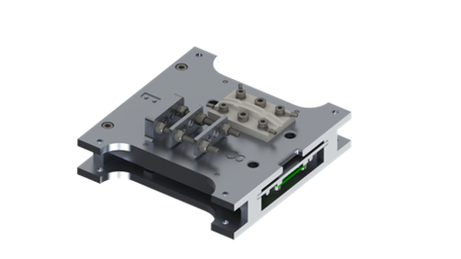
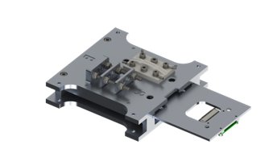
Validating the Antenna
Demonstrate the TPA’s capability to downlink in the space environment
Analyze the changes of the TPA during orbit
Measure the impact the TPA has on solar panel power generation
Notes:
Demonstrate the capability – downlink a test packet and validate that the ground station receives the full packet
Analyze the changes – print layer around TPA and measure the inductance, if it changes it tells us the TPA has changed (also CDS)
Measure power generation – have a control solar panel on the same face to compare the generation of the solar panel with TPA to

Slide 14

Why Space?
Tests the TPA in an applicable environment
Advances the technology readiness level (TRL) aka flight heritage
Provides students the opportunity to design with the full scope of space engineering in mind
Perform mission operations
Notes:
- Space simulation chambers on Earth are an option but far too expensive for the team
- Can’t simulate all conditions of space concurrently
- Costly to simulate over an extended period of time
- Important one is TVAC while transmitting (can’t do TVAC in an anechoic chamber)
- Everyone always asks about flight heritage on systems, putting this antenna in space will give it flight heritage
- That combination gets students comfortable with the mindset needed for space engineering

Slide 15
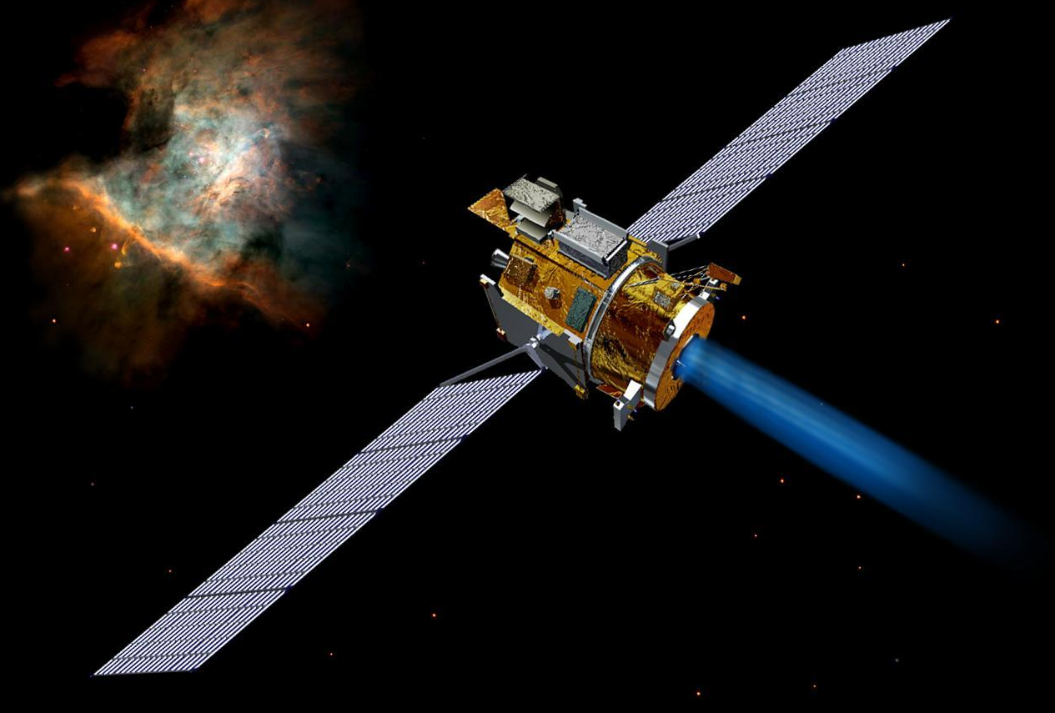

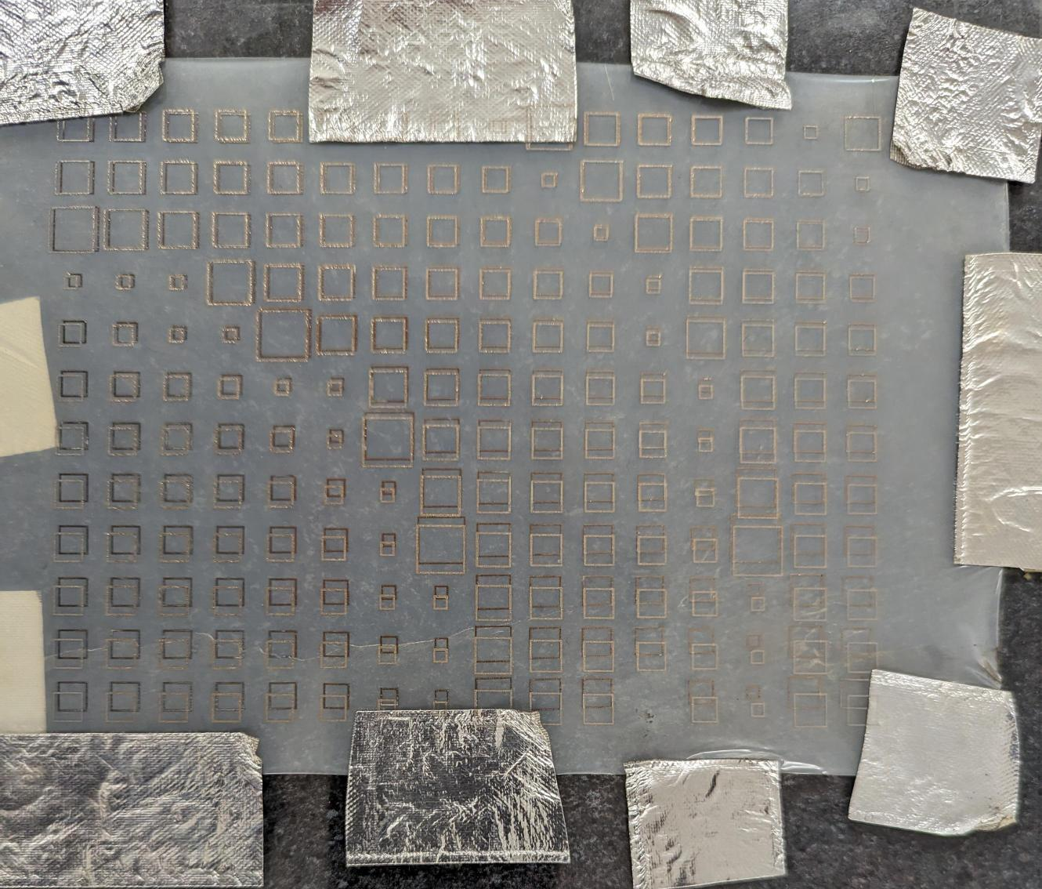
Strategic Objective 3.1: Develop Revolutionary Technologies
2022 NASA Strategic Plan
Develop revolutionary, high-payoff space technologies driven by diverse ideas to transform NASA missions and ensure American leadership in the space economy
Notes:
- Talk about applications
- Deep space, sun and transmission vector closely align (could put an array like in the picture on a big solar panel)
- LEO CubeSat missions have a need for power generation and faster data rates
- Could put a sensor in that area where it was required to have a solar panel (suggested by a member of industry)

Slide 16
Educational Merit
Presented by: Bella Nielsen, Outreach Director
Notes:
- Now I will turn the time over to… for the…
- Short introduction of Bella

Slide 17
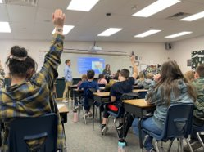
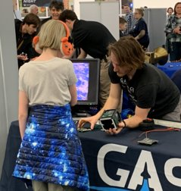
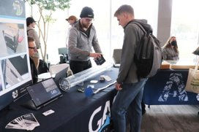
Strategy 4.2
2020-2024 NASA Science Plan
Purposefully and actively engage with audiences and learners of all ages to share the story of NASA's integrated science program
Notes:
- Share NASA’s science through our outreach
- Outreach includes going to local schools and participating in university events
- Teach students about the GASRATS mission with an emphasis on radio communications (including ground station)
- Supported by building a portable ground station
- Goal is to inspire students; we got our spark somewhere, GASRATS can be this spark for the next generation
- The culmination of outreach for the GASRATS mission will be the BUSS program

Slide 18
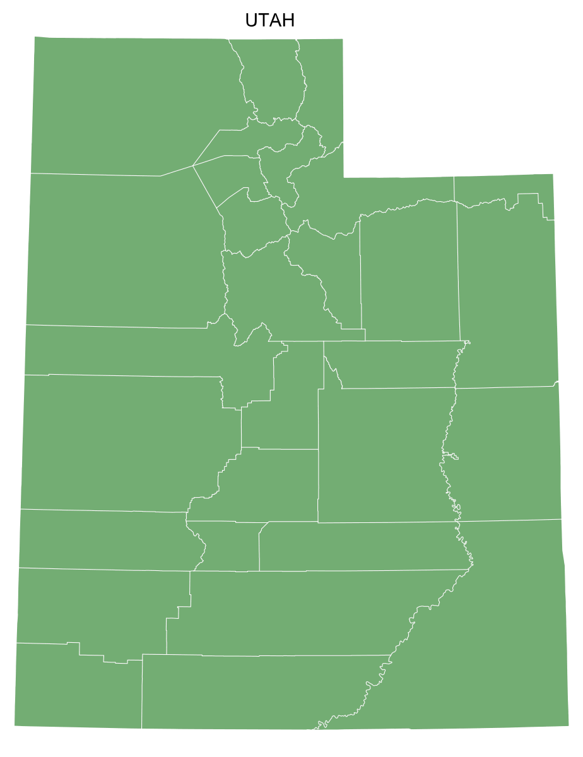

Strategy 4.2: Engage All Ages
Bring Utah Students to Space
Opportunity for all Utah K-12 students to have their names flown on the BUSS Payload
42 school districts, 945 schools, 665,000 students
Interact directly with GASRATS and space
Notes:
- BUSS Payload will be integrated on GASRATS and flown in space
- Students get to interact directly with space
- Shares that students can work in space, even as undergrads
- Space goes from being a far-off dream, to being something attainable
- By working on this team, I learned that my dreams of sending things to space are a very achievable goal
- This is what we want to share with students; we want them to know that while space is hard, it is possible
- Portray specific opportunities available to students and where they can take their futures, including at NASA
- Wide reach of this program to K-12 students creates the potential to impact the wider community
Magic School Bus picture: https://i.pinimg.com/originals/ac/85/60/ac85607545d99a3cd02441ca5b5423e9.png
Utah Counties Map picture: https://suncatcherstudio.com/uploads/patterns/usa-county-maps/states/blank-maps/png-medium/utah-county-map-blank-fefefe-77aa77.png

Slide 19
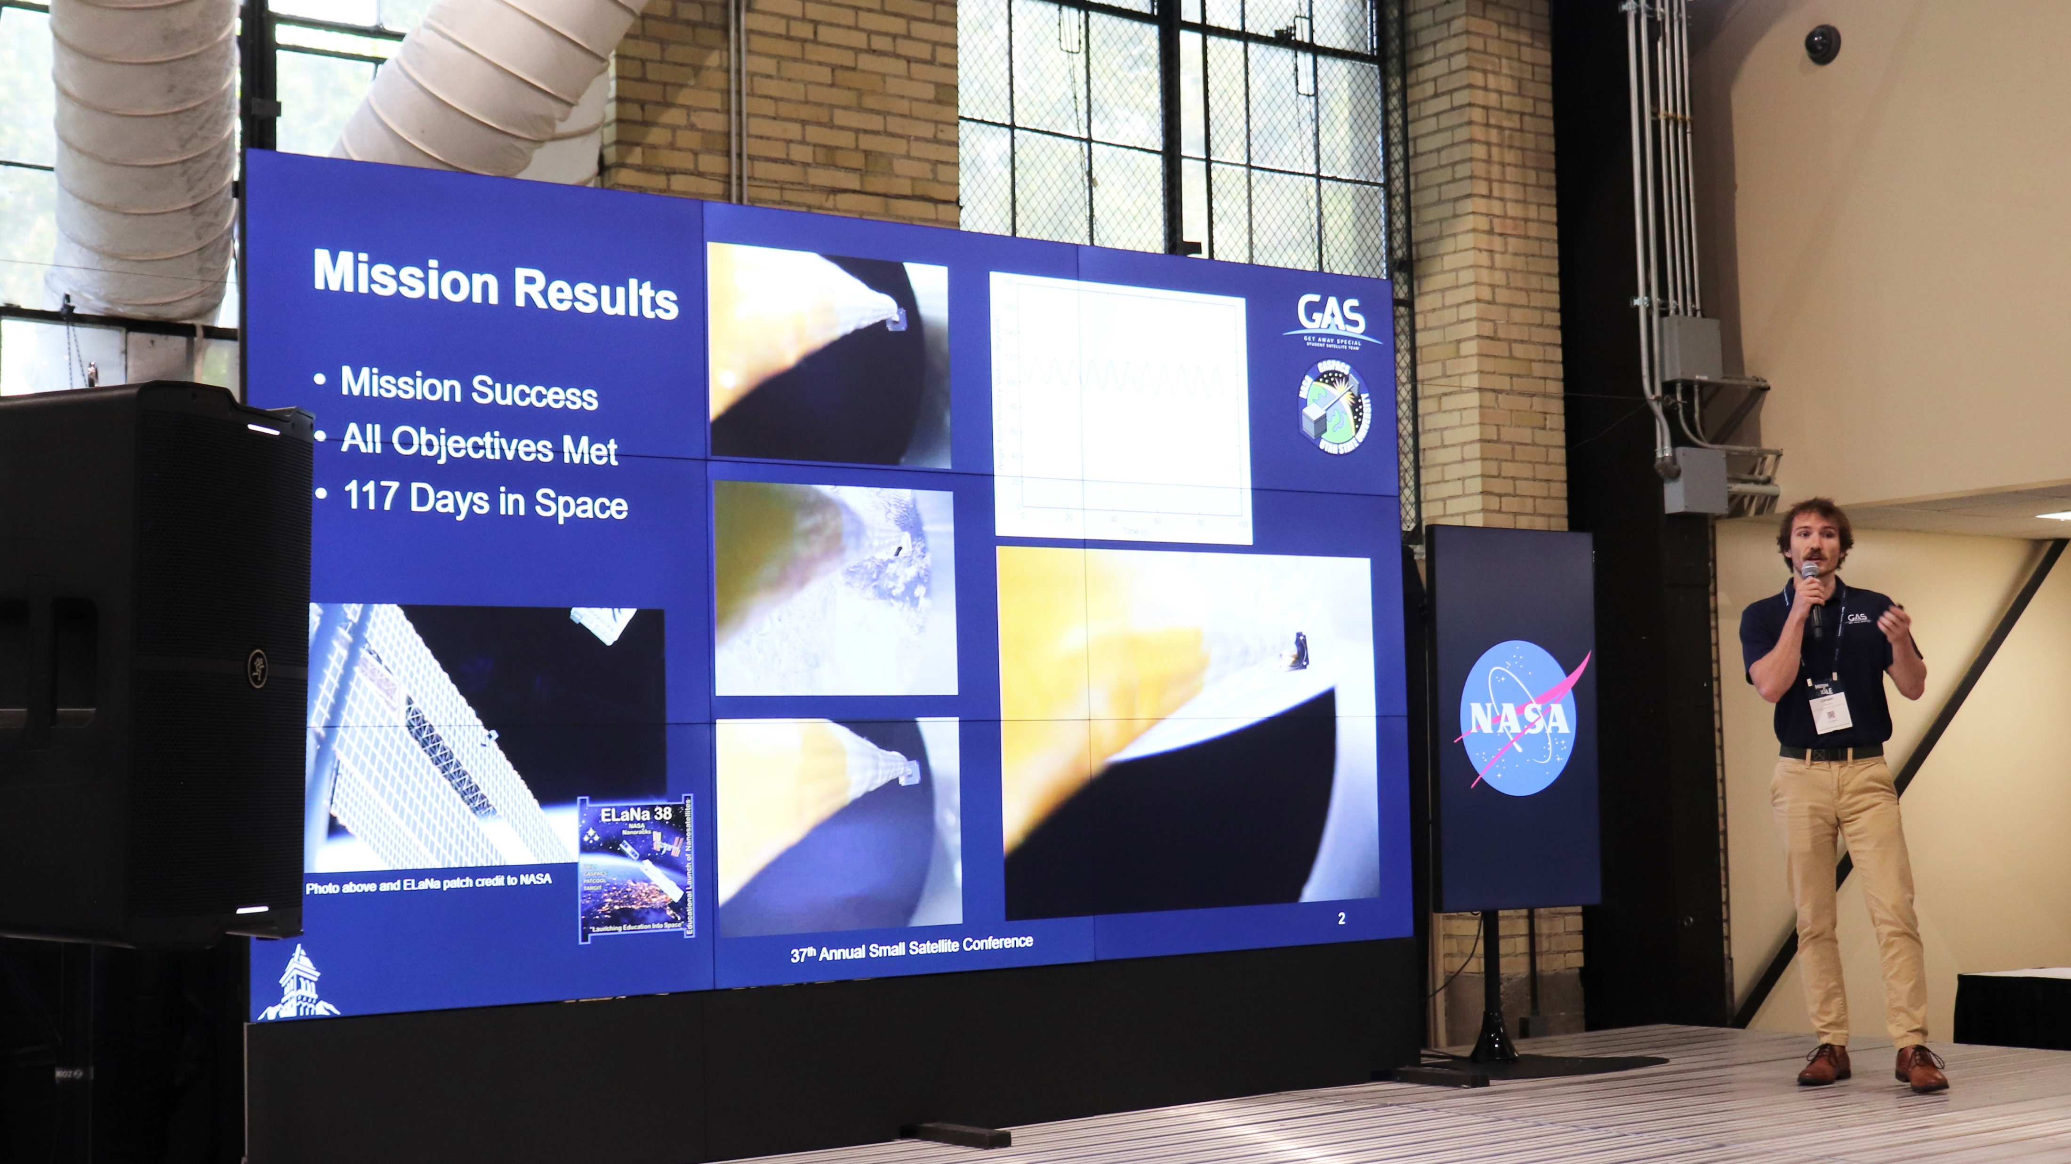
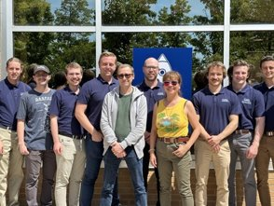
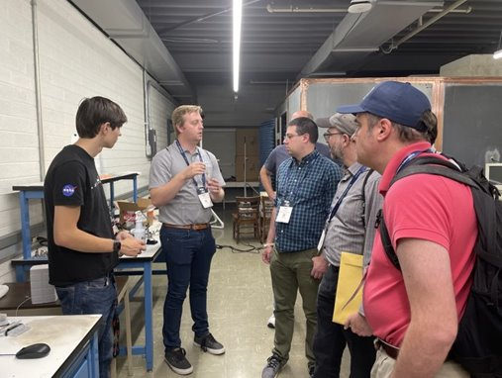
Strategic Objective 1.2
2020-2023 NASA Strategy for STEM Engagement
Create structured and widely-accessible, experiential learning opportunities for students to engage with NASA's experts and help solve problems that are critical to NASA's mission
Notes:
- Present about GASRATS at conferences like SmallSat, allowing members to interact directly with NASA and their experts
- Having a project that will fly in small makes attending the conferences more meaningful
- We can get feedback on our ideas, share what we have learned from GASPACS, as well as learn from others’ experience in space
- Interact with industry (important for learning about systems)
- Connections with JPL for flight software (reference to picture as a transition to the next slide)

Slide 20

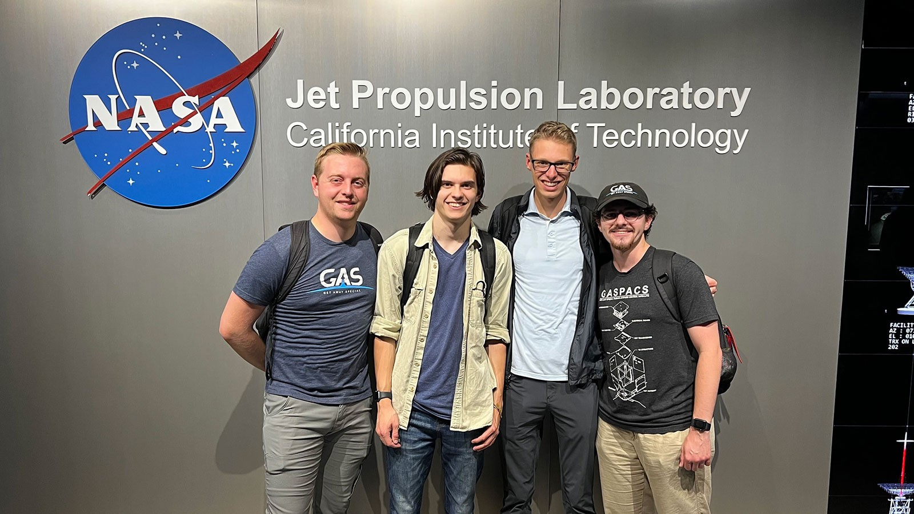
Strategic Objective 1.2: NASA’s Experts and Missions
F’ software developed by NASA Jet Propulsion Laboratory
JPL F’ Workshop
GAS Team members have contact with F’ developers
GAS Team will provide input to F’
Notes:
- Open-source software framework
- Initial contact and invite to workshop came from SmallSat 2022
- Maintain contact with developers, including holding a review of the team’s software plan
- Lead FSW engineer interned with JPL working on F’, creating a better connection, first name basis with F’ developers
- Get feedback as we are creating our own modules for the GASRATS FSW
- Connection allows the GAS Team to provide input about how we are implementing F’
- Working with JPL to make F’ effective for space satellites operating in space
- GASRATS operating in orbit with F’ is an extensive test of how the software framework will operate

Slide 21
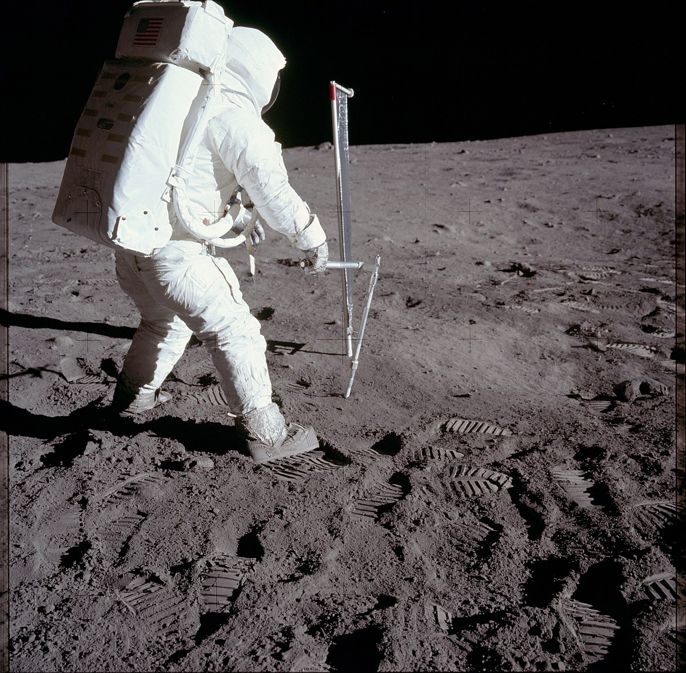
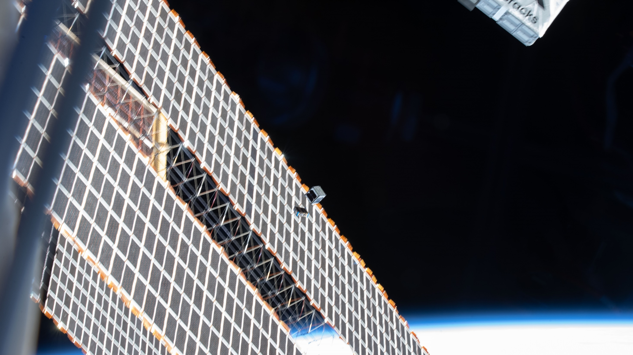
Strategic Objective 4.3
2022 NASA Strategic Plan
Build the next generation of explorers
Notes:
- Students can join with little experience and then gain skills and knowledge valuable to their careers in space, whether working for NASA itself or another company/institution working with NASA and on NASA’s missions
- These include solving complex problems and understanding considerations for space mission design
- GASRATS features a variety of systems and team member roles, providing students lots of opportunities to find what they are passionate about
- One of our team members and his experience with the GASRATS ADCS is an excellent example of this

Slide 22
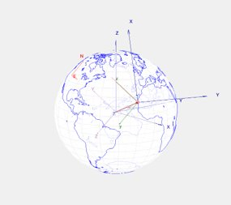
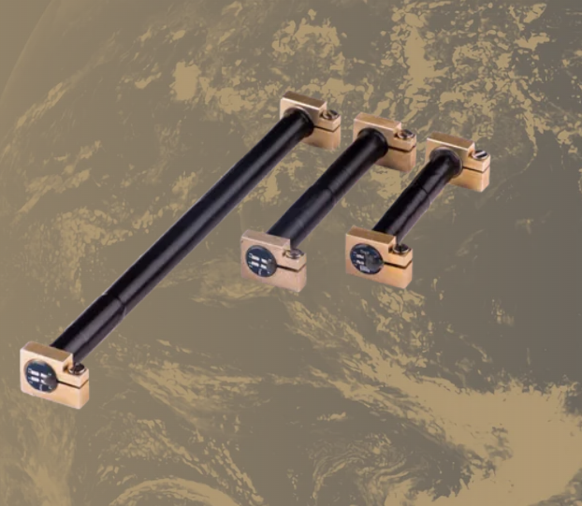
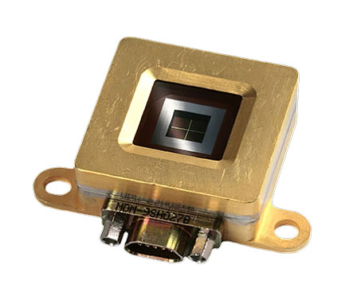
Strategic Objective 4.3: Explorers
ADCS required to point the antenna at the Earth
3-axis magnetorquer-only attitude control
Newly designed technology
Reduces cost of ADCS units significantly
Opportunity to find a passion for GNC
Notes:
- The payload is a directional S-band patch antenna, requiring ADCS
- Cost went from $50,000 with a commercial system to $5,000
-Cost savings is a nice benefit for our team and the space industry, but the real value was in having to develop the ADCS ourselves, rather than just buying a plug and play commercial system
- For Ben Willard, graduate advisor, developing the ADCS for GASRATS was an opportunity to find a passion for GNC and is now pursing GNC as a career
GNC – guidance, navigation, and control
- ADCS will continue to be an opportunity for students to learn about GNC
- Operating the GASRATS ADCS in orbit will give students confidence in their abilities to engineer systems capable of withstanding the space environment
- Students can take the confidence gained from working on a project going to space into their careers, encouraging them to venture deeper into the space industry

Slide 23
Conclusion
Presented by: Carter Page, Team Coordinator

Slide 24
Conclusion
Strategic Objective 3.1: Develop revolutionary technologies that will benefit NASA’s missions and the American space economy
Transparent Patch Antenna
Strategy 4.2: Engage people of all ages with NASA’s science
BUSS Program
Strategic Objective 1.2: Create learning opportunities by engaging students with NASA’s experts and missions
F’ Flight Software Framework
Strategic Objective 4.3: Build the next generation of explorers
Members finding their passions
Notes:
We believe that the GASRATS mission aligns strongly with these four NASA strategic objectives.

Slide 25
Feedback Submission
Google Form
How well does the GASRATS mission align with NASA’s goals and objectives?
Is a launch opportunity necessary to achieve the objectives of the GASRATS mission?
How might we be able to improve our presentations in the future (such as Feasibility Review next month)?
Any other feedback is welcomed!
We plan to respond to all given feedback by October 14
Notes:
We appreciate you attending today, and we appreciate any feedback you can offer, good or bad! We are not afraid of criticism and see it as a crucial step towards getting our names in space.
The Google Form will also ask for some information about you, including your resume/CV. This information will be used in our proposal to help us explain to NASA why you’re qualified.
Our goal is to follow up with all reviewers by October 14 (3 weeks from now) on how we plan to respond to their feedback and if we plan to make any changes to the GASRATS mission.

Slide 26
Thank you for attending the GASRATS Merit Review!
We hope you will join us for the GASRATS Feasibility Review on October 28, 10:00 AM MDT.
For further questions, please email Carter Page at coordinator@gas.usu.edu

Slide 27
References
NASA CSLI
2023 CSLI AoPo
NASA Strategic Plan
NASA Strategy for STEM Engagement
NASA Science Plan
NASA F’ Flight Software Framework
GAS Team Website

